Slide 1
UNIT - I
18CSC302J - COMPUTER NETWORKS

Slide 2
Course Outcome
The purpose of learning this unit is to:
CLR-1 : Describe the importance of various Internet protocols like ARP, RARP, ICMP, Multicasting and multi routing, SCTP.
At the end of this unit, learners will be able to:
CLO-1 : Identify the basics of different types of network and transport layer protocols.

Slide 3
OBJECTIVES:
INTERNET PROTOCOL VERSION 4
To explain the general idea behind the IP protocol and the position of IP in TCP/IP protocol suite.
To show the general format of an IPv4 datagram.
To discuss fragmentation and reassembly of datagrams.
To discuss several options that can be in an IPv4 datagram and their applications.
To show how a checksum is calculated for the header of an IPv4 datagram at the sending site and how the checksum is checked at the receiver site.

Slide 4
Introduction of IP
The Internet Protocol (IP) is the transmission mechanism used by the TCP/IP protocols at the network layer.
IP is an unreliable and connectionless datagram protocol—a best-effort delivery service.
The term best-effort means that IP packets can be corrupted, lost, arrive out of order, or delayed and may create congestion for the network.
IP is also a connectionless protocol for a packet switching network that uses the datagram approach.
This means that each datagram is handled independently, and each datagram can follow a different route to the destination.
This implies that datagrams sent by the same source to the same destination could arrive out of order, some could be lost or corrupted during transmission.

Slide 5
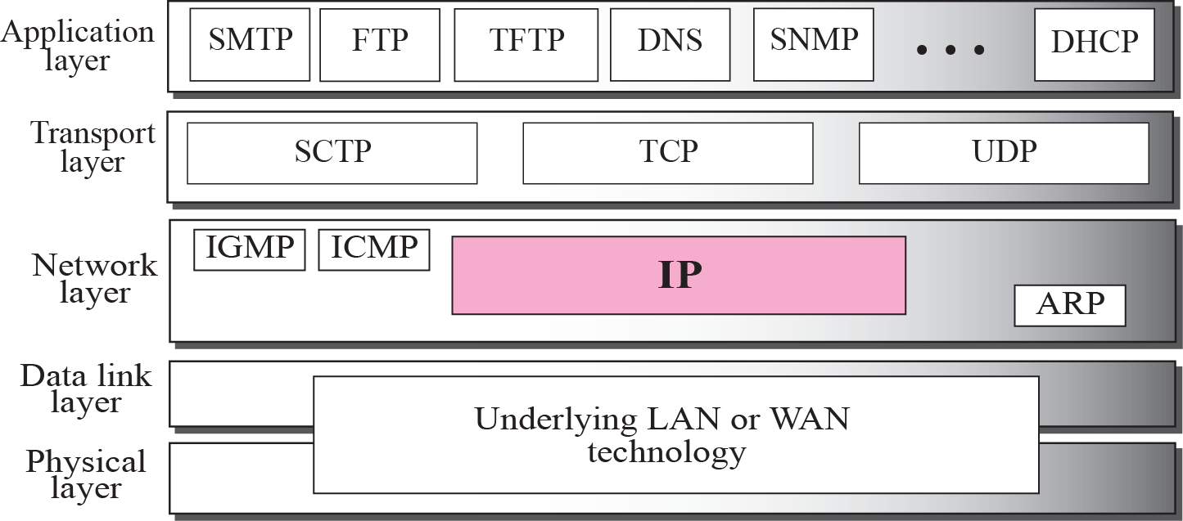
Figure 1.1 Position of IP in TCP/IP protocol suite

Slide 6
IP Datagrams
Packets in the network (internet) layer are called datagrams.
A datagram is a variable-length packet consisting of two parts: header and data.
The header is 20 to 60 bytes in length and contains information essential to routing and delivery.
It is customary in TCP/IP to show the header in 4-byte sections.
A brief description of each field are on next slide.

Slide 7
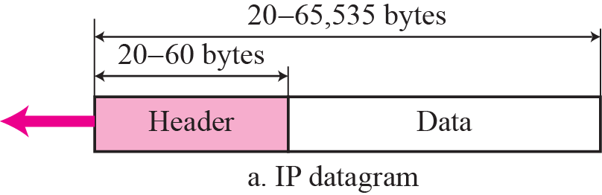
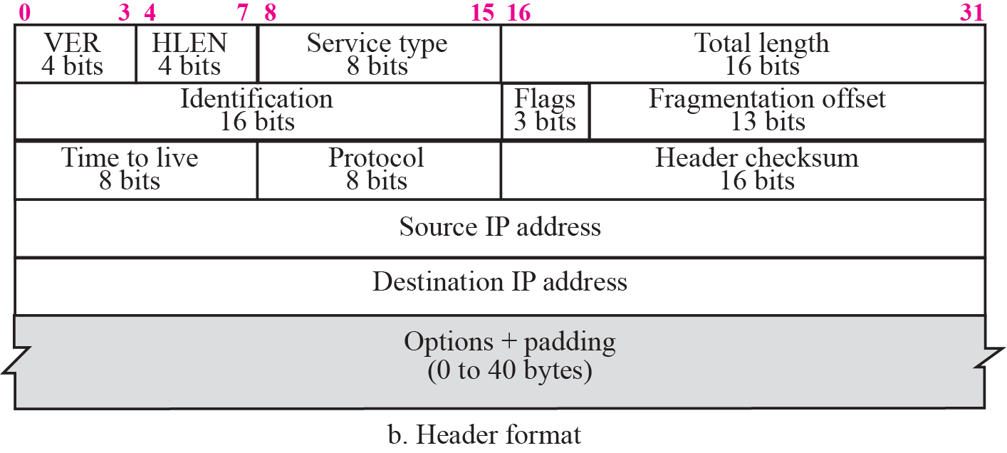
Figure 1.2 IP datagram

Slide 8
Header Format
Version (VER): This 4-bit field defines the version of the IP protocol. Currently the version is 4.
Header length (HLEN): This 4-bit field defines the total length of the datagram header in 4-byte words. This field is needed because the length of the header is variable (between 20 and 60 bytes).
Service type: In the original design of IP header, this field was referred to as type of service (TOS), which defined how the datagram should be handled. This field now defines a set of differentiated services. The new interpretation is shown in Figure 1.3.
The codepoint subfield can be used in two different ways.
When the 3 right-most bits are 0s, the 3 left-most bits are interpreted the same as the precedence bits in the service type interpretation.
When the 3 right-most bits are not all 0s, the 6 bits define 56 (64 − 8) services based on the priority assignment by the Internet or local authorities according to Table 1.1.

Slide 9
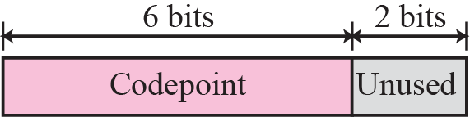
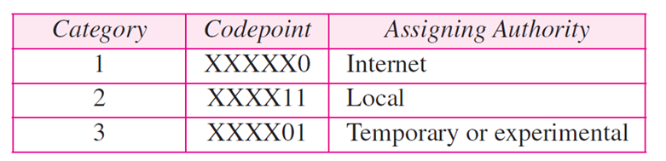
Figure 1.3 Service type
Table 1.1 Values of Codepoints

Slide 10

Header Format
Total length: This is a 16-bit field that defines the total length (header plus data) of the IP datagram in bytes.
Length of data = total length − header length
Identification: This field is used in fragmentation.
Flags: This field is used in fragmentation.
Fragmentation offset: This field is used in fragmentation.
Time to live: A datagram has a limited lifetime in its travel through an internet. This field was originally designed to hold a timestamp, which was decremented by each visited router. The datagram was discarded when the value became zero.
Figure 1.4 Encapsulation of a small datagram in an Ethernet frame

Slide 11
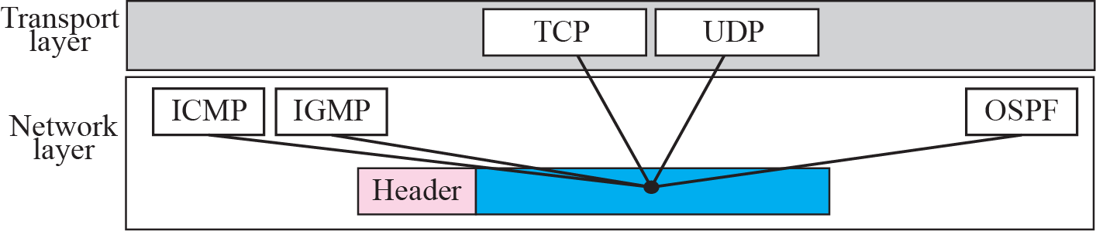
Header Format Cont.
Protocol: This 8-bit field defines the higher-level protocol that uses the services of the IP layer. An IP datagram can encapsulate data from several higher level protocols such as TCP, UDP, ICMP, and IGMP.
The IP protocol multiplexes and demultiplexes data from different higher-level protocols, the value of this field helps in the demultiplexing process when the datagram arrives at its final destination (see Figure 1.5).
Figure 1.5 Multiplexing

Slide 12
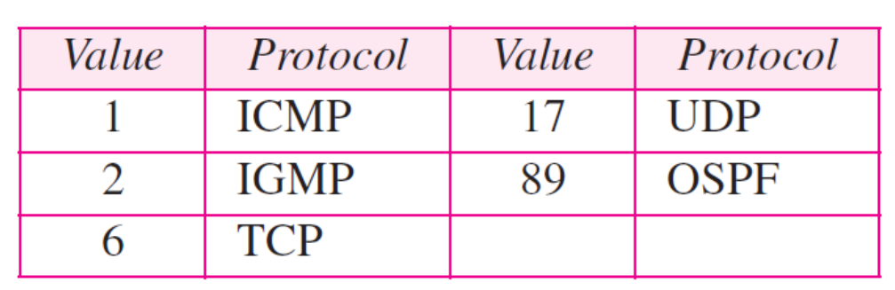
Header Format Cont.
Some of the value of this field for different higher-level protocols is shown in Table 1.2.
Checksum: The checksum concept and its calculation.
Source address: This 32-bit field defines the IP address of the source.
Destination address: This 32-bit field defines the IP address of the destination.
Source and Destination address field must remain unchanged during the time the IP datagram travels from the source host to the destination host.
Table 1.2 Protocols

Slide 13
Example 1.1
An IP packet has arrived with the first 8 bits as shown:
The receiver discards the packet. Why?
Solution
There is an error in this packet. The 4 left-most bits (0100) show the version, which is correct. The next 4 bits (0010) show the wrong header length (2 × 4 = 8). The minimum number of bytes in the header must be 20. The packet has been corrupted in transmission.
Example 1.2
In an IP packet, the value of HLEN is 1000 in binary. How many bytes of options are being carried by this packet? Solution
The HLEN value is 8, which means the total number of bytes in the header is 8 × 4 or 32 bytes. The first 20 bytes are the base header, the next 12 bytes are the options.

Slide 14
Example 1.3
In an IP packet, the value of HLEN is 5₁₆ and the value of the total length field is 0028₁₆. How many bytes of data are being carried by this packet?
Solution
The HLEN value is 5, which means the total number of bytes in the header is 5 × 4 or 20 bytes (no options). The total length is 40 bytes, which means the packet is carrying 20 bytes of data (40 − 20).
Example 1.4
An IP packet has arrived with the first few hexadecimal digits as shown below:
How many hops can this packet travel before being dropped? The data belong to what upper layer protocol?
Solution
To find the time-to-live field, we skip 8 bytes (16 hexadecimal digits). The time-to-live field is the ninth byte, which is 01. This means the packet can travel only one hop. The protocol field is the next byte (02), which means that the upper layer protocol is IGMP (see Table 1.2)

Slide 15
IP Fragmentation
A datagram can travel through different networks.
Each router decapsulates the IP datagram from the frame it receives, processes it, and then encapsulates it in another frame.
The format and size of the received frame depend on the protocol used by the physical network through which the frame has just traveled.
The format and size of the sent frame depend on the protocol used by the physical network through which the frame is going to travel.
Maximum Transfer Unit (MTU)
Each data link layer protocol has its own frame format in most protocols. One of the fields defined in the format is the maximum size of the data field.
When a datagram is encapsulated in a frame, the total size of the datagram must be less than this maximum size, which is defined by the restrictions imposed by the hardware and software used in the network.

Slide 16

IP Fragmentation Cont.
Figure 7.6 MTU
When a datagram is fragmented, each fragment has its own header with most of the fields repeated, but some changed.
A fragmented datagram may itself be fragmented if it encounters a network with an even smaller MTU.
In other words, a datagram can be fragmented several times before it reaches the final destination.
A datagram can be fragmented by the source host or any router in the path.

Slide 17
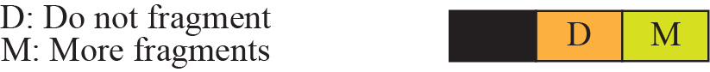
IP Fragmentation Cont.
Fields Related to Fragmentation
The fields that are related to fragmentation and reassembly of an IP datagram are the identification, flags, and fragmentation offset fields.
Identification: This 16-bit field identifies a datagram originating from the source host. The combination of the identification and source IP address must uniquely define a datagram as it leaves the source host.
Flags: This is a three-bit field.
The first bit is reserved (not used).
The second bit is called the do not fragment bit.
The third bit is called the more fragment bit.
Figure 1.7 Flags field

Slide 18
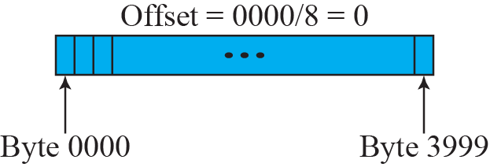
IP Fragmentation Cont.
Fragmentation offset: This 13-bit field shows the relative position of this fragment with respect to the whole datagram. It is the offset of the data in the original datagram measured in units of 8 bytes.
Figure 1.8 shows a datagram with a data size of 4000 bytes fragmented into three fragments.
Figure 1.8 Fragmentation example

Slide 19
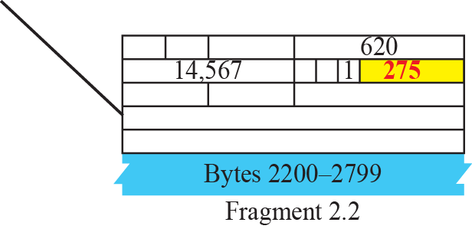
IP Fragmentation Cont.
Notice the value of the identification field is the same in all fragments. Notice the value of the flags field with the more bit set for all fragments except the last.
Figure 1.9 Detailed fragmentation example

Slide 20
Example 1.5
A packet has arrived with an M bit value of 0. Is this the first fragment, the last fragment, or a middle fragment? Do we know if the packet was fragmented?
Solution
If the M bit is 0, it means that there are no more fragments; the fragment is the last one. However, we cannot say if the original packet was fragmented or not. A nonfragmented packet is considered the last fragment.
Example 1.6
A packet has arrived with an M bit value of 1. Is this the first fragment, the last fragment, or a middle fragment? Do we know if the packet was fragmented?
Solution
If the M bit is 1, it means that there is at least one more fragment. This fragment can be the first one or a middle one, but not the last one. We don’t know if it is the first one or a middle one; we need more information (the value of the fragmentation offset). See also the next example.

Slide 21
Example 1.7
A packet has arrived with an M bit value of 1 and a fragmentation offset value of zero. Is this the first fragment, the last fragment, or a middle fragment?
Solution
Because the M bit is 1, it is either the first fragment or a middle one. Because the offset value is 0, it is the first fragment.
Example 1.8
A packet has arrived in which the offset value is 100. What is the number of the first byte? Do we know the number of the last byte?
Solution
To find the number of the first byte, we multiply the offset value by 8. This means that the first byte number is 800. We cannot determine the number of the last byte unless we know the length of the data.

Slide 22
Example 1.9
A packet has arrived in which the offset value is 100, the value of HLEN is 5 and the value of the total length field is 100. What is the number of the first byte and the last byte?
Solution
The first byte number is 100 × 8 = 800. The total length is 100 bytes and the header length is 20 bytes (5 × 4), which means that there are 80 bytes in this datagram. If the first byte number is 800, the last byte number must be 879.

Slide 23
IP Fragmentation Options
The header of the IP datagram is made of two parts: a fixed part and a variable part.
The fixed part is 20 bytes long and was discussed in the previous section.
The variable part comprises the options, which can be a maximum of 40 bytes.
Options, as the name implies, are not required for a datagram. They can be used for network testing and debugging.
Although options are not a required part of the IP header, option processing is required of the IP software.
This means that all implementations must be able to handle options if they are present in the header.

Slide 24
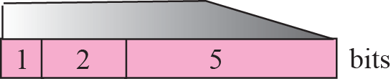
Figure 1.10 Option format
It is composed of a 1-byte type field, a 1-byte length field, and a variable-sized value field.
The three fields are often referred to
as type-length-value or TLV.

Slide 25
IP Fragmentation Options Cont.
Type: The type field is 8 bits long and contains three subfields: copy, class, and number.
Copy: This 1-bit subfield controls the presence of the option in fragmentation.
value is 0, the option must be copied only to the first fragment.
value is 1, the option must be copied to all fragments.
Class: This 2-bit subfield defines the general purpose of the option.
Value is 00, option is used for datagram control.
Value is10, option is used for debugging and management.
The other two possible values (01 and 11) have not yet been defined.
Number: This 5-bit subfield defines the type of option.
Although 5 bits can define up to 32 different types, currently only 6 types are in use.
Length: the total length of the option including the type field and the
length field itself.
This field is not present in all of the option types.
Value: the data that specific options require.
Like the length field, this field is also not present in all option types.

Slide 26
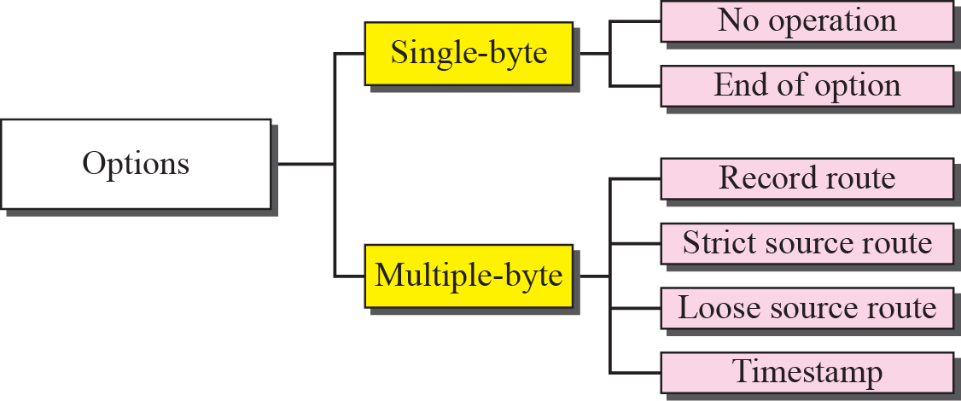
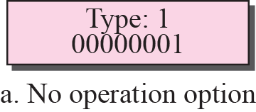
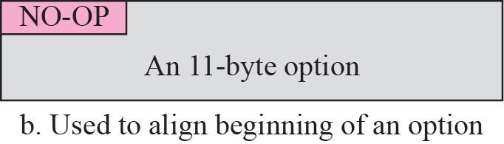
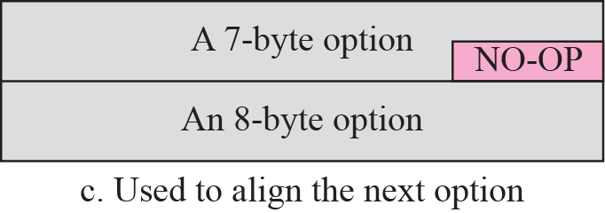
Option Types
Figure 1.11 Categories of options
No-Operation: It is a 1-byte option used as a filler between options. For example, it can be used to align the next option on a 16-bit or 32-bit boundary
Figure 1.12 No operation option

Slide 27
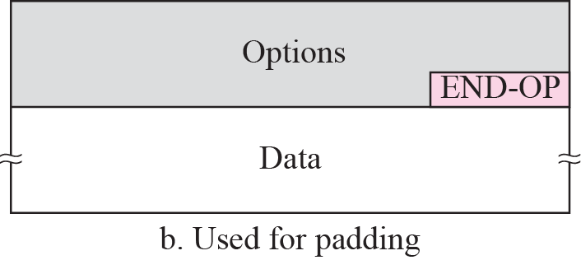
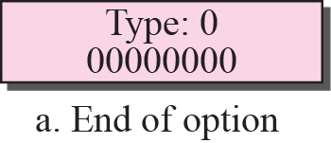
End-of-Option Option:
An end-of-option option is also a 1-byte option used for padding at the end of the
option field.
It can only be used as the last option.
Only one end-of-option option can be used.
After this option, the receiver looks for the payload data.
Figure 1.13 Endo-of-option option
Record-Route Option:
A record-route option is used to record the Internet routers that handle the datagram. It can list up to nine router IP addresses since the maximum size of the header is 60 bytes, which must include 20 bytes for the base header.
This implies that only 40 bytes are left over for the option part.
The source creates placeholder fields in the option to be filled by the visited routers.

Slide 28
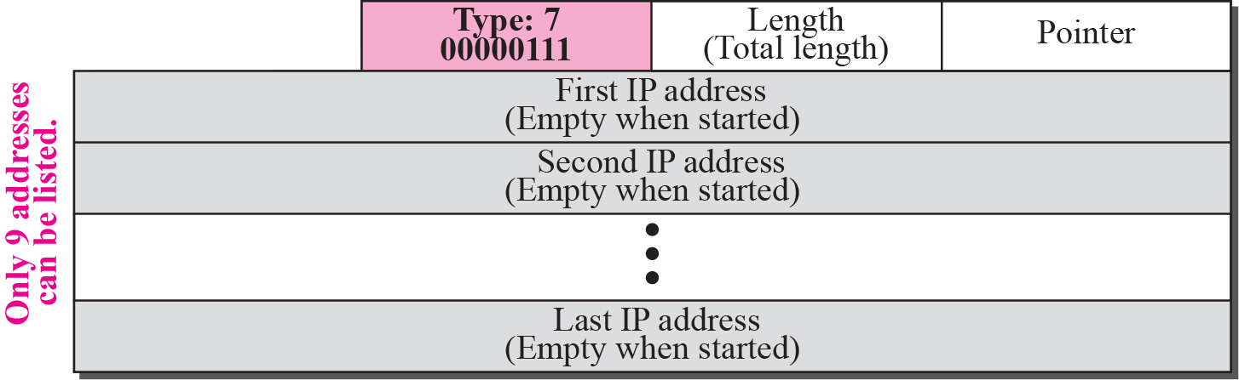
Figure 1.14 Record-route option
When the datagram is traveling, each router that processes the datagram compares
the value of the pointer with the value of the length.
If the value of the pointer is greater than the value of the length, the option is full and no changes are made.
The pointer field is an offset integer field containing the byte number of the first empty entry. In other words, it points to the first available entry.
the router adds the IP address of its interface from which the datagram is leaving.
The router then increments the value of the pointer by 4.

Slide 29
Figure 1.15 Record-route concept
4
8
Strict-source-route option:
It is used by the source to predetermine a route for the datagram as it travels through the Internet.
Dictation of a route by the source can be useful for several purposes.
The sender can choose a route with a specific type of service, such as minimum delay or maximum throughput.
Alternatively, it may choose a route that is safer or more reliable for the sender’s purpose.

Slide 30
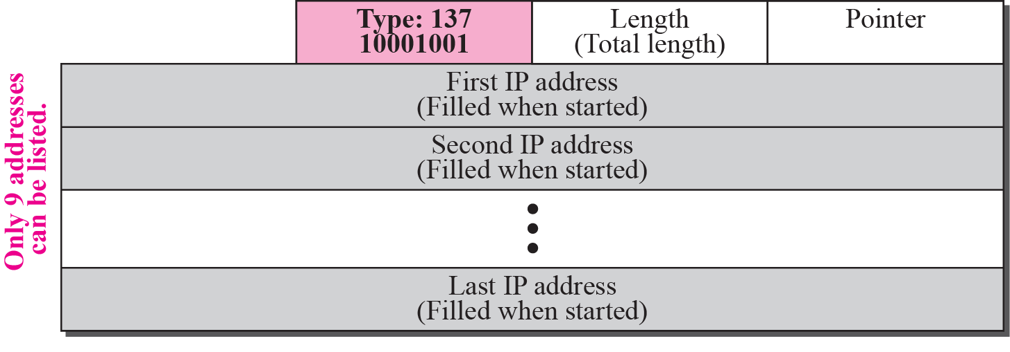
Figure 1.16 Strict-source-route option
Figure 1.17 Strict-source-route option

Slide 31
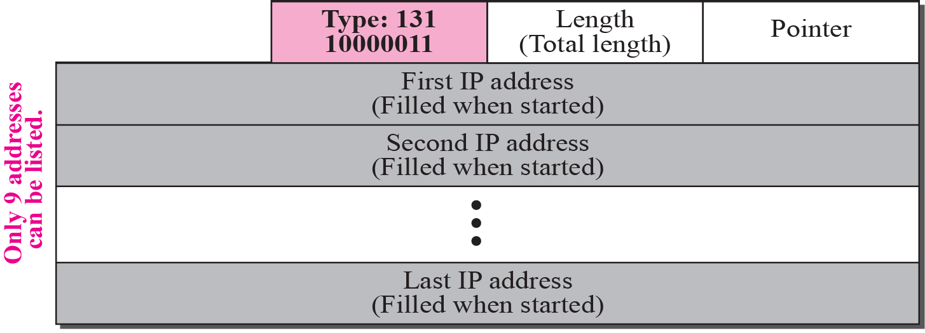
Figure 1.18 Loose-source-route option
A loose-source-route option is similar to the strict source route, but it is more relaxed.
Each router in the list must be visited, but the datagram can visit other routers as well.
Timestamp: used to record the time of datagram processing by a router.
The time is expressed in milliseconds from midnight, Universal Time.
However, no privileged users of the Internet are not usually aware of the physical
topology of the Internet.

Slide 32
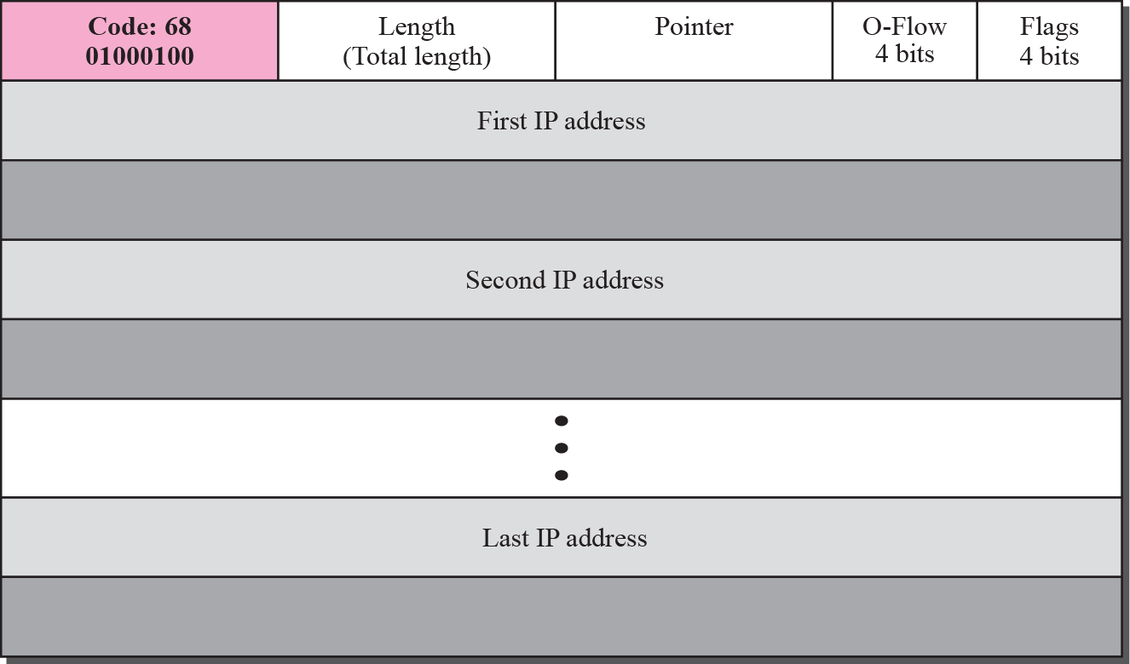
Figure 1.19 Time-stamp option
The flags field specifies the visited router responsibilities. If the flag value is 0, each router adds only the timestamp in the provided field. If the flag value is 1, each router must add its outgoing IP address and the timestamp. If the value is 3, the IP addresses are given, and each router must check the given IP address with its own incoming IP address.

Slide 33
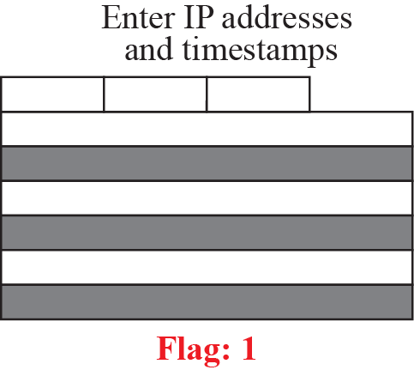
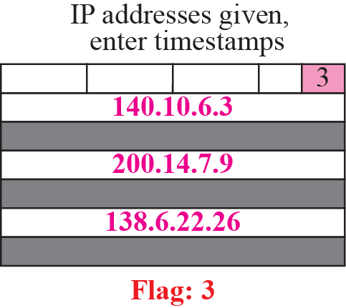
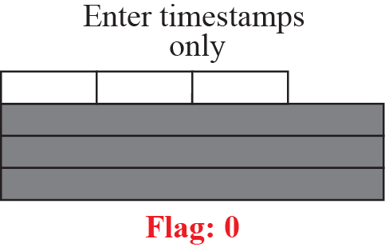
Figure 1.20 Use of flags in timestamp
Figure 1.21 Timestamp concept

Slide 34
Example 1.10
Which of the six options must be copied to each fragment?
Solution
We look at the first (left-most) bit of the type for each option.
a. No operation: type is 00000001; not copied.
b. End of option: type is 00000000; not copied.
c. Record route: type is 00000111; not copied.
d. Strict source route: type is 10001001; copied.
e. Loose source route: type is 10000011; copied.
f. Timestamp: type is 01000100; not copied.
Example 1.11
Which of the six options are used for datagram control and which
for debugging and managements?
Solution
We look at the second and third (left-most) bits of the type.
a. No operation: type is 00000001; datagram control.
b. End of option: type is 00000000; datagram control.
c. Record route: type is 00000111; datagram control.
d. Strict source route: type is 10001001; datagram control.
e. Loose source route: type is 10000011; datagram control.
f. Timestamp: type is 01000100; debugging and management control.

Slide 35
Example 1.12
One of the utilities available in UNIX to check the traveling of the IP packets is ping. In the next chapter, we talk about the ping program in more detail. In this example, we want to show how to use the program to see if a host is available. We ping a server at De Anza College named fhda.edu. The result shows that the IP address of the host is 153.18.8.1. The result also shows the number of bytes used.

Slide 36
Example 1.13
We can also use the ping utility with the -R option to implement the record route option. The result shows the interfaces and IP addresses.
Example 1.14
The traceroute utility can also be used to keep track of the route of a packet. The result shows the three routers visited.

Slide 37
Example 1.15
The traceroute program can be used to implement loose source routing. The -g option allows us to define the routers to be visited, from the source to destination. The following shows how we can send a packet to the fhda.edu server with the requirement that the packet visit the router 153.18.251.4.
Example 1.16
The traceroute program can also be used to implement strict source routing. The -G option forces the packet to visit the routers defined in the command line. The following shows how we can send a packet to the fhda.edu server and force the packet to visit only the router 153.18.251.4.

Slide 38
CHECKSUM
The error detection method used by most TCP/IP protocols is called the checksum.
The checksum protects against the corruption that may occur during the transmission of a packet.
It is redundant information added to the packet.
The checksum is calculated at the sender and the value obtained is sent with the packet.
The receiver repeats the same calculation on the whole packet including the checksum.
If the result is satisfactory (see below), the packet is accepted; otherwise, it is rejected.

Slide 39
Checksum Calculation at the Sender
At the sender, the packet header is divided into n-bit sections (n is usually 16).
These sections are added together using one’s complement arithmetic, resulting in a sum that is also n bits long.
The sum is then complemented (all 0s changed to 1s and all 1s to 0s) to produce the checksum.
Checksum Calculation at the Receiver
The receiver divides the received packet into k sections and adds all sections.
It then complements the result.
If the final result is 0, the packet is accepted; otherwise, it is rejected.
Figure 1.22 shows graphically what happens at the sender and the receiver.

Slide 40
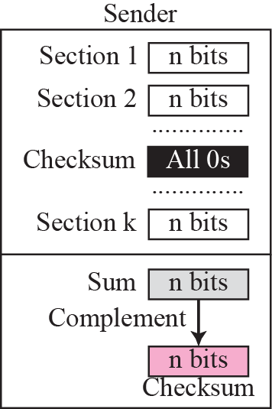
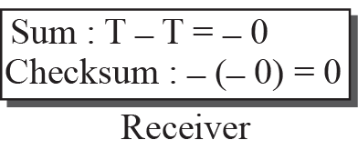
Figure 1.22 Checksum concept
Figure 1.23 Checksum in one’s complement arithmetic

Slide 41
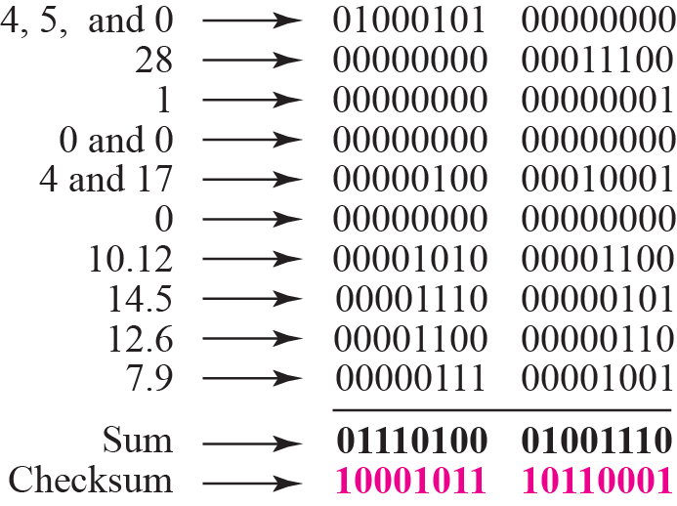
Example 1.17
Figure 1.24 shows an example of a checksum calculation at the sender site for an IP header without options. The header is divided into 16-bit sections. All the sections are added and the sum is complemented. The result is inserted in the checksum field.
Figure 1.24 Example of checksum calculation at the sender

Slide 42
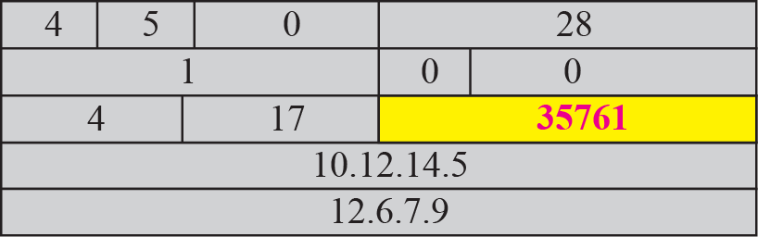
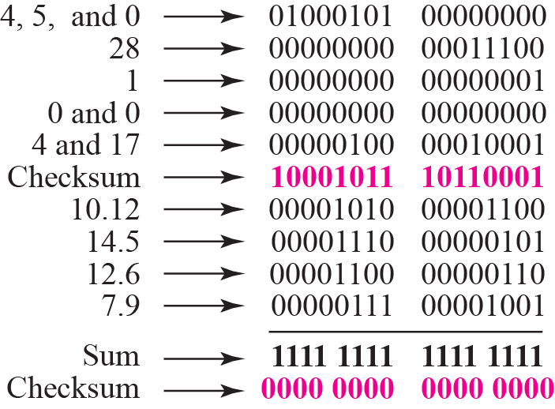
Example 1.18
Figure 1.25 shows the checking of checksum calculation at the receiver site (or intermediate router) assuming that no errors occurred in the header. The header is divided into 16-bit sections. All the sections are added and the sum is complemented. Since the result is 16 0s, the packet is accepted.
Figure 1.25 Example of checksum calculation at the receiver

Slide 43
OBJECTIVES:
Address Resolution Protocol
To make a distinction between logical address (IP address) and physical address (MAC address).
To describe how the mapping of a logical address to a physical address can be static or dynamic.
To show how the address resolution protocol (ARP) is used to dynamically map a logical address to a physical address.
To show that the proxy ARP can be used to create a subnetting effect.
To show that an ARP software package can be made of five components.

Slide 44
ADDRESS MAPPING
The hosts and routers are recognized at the network level by their logical addresses.
A logical address is an internetwork address and unique universally. It is called a logical address because it is usually implemented in software.
Every protocol that deals with interconnecting networks requires
logical addresses.
The logical addresses in the TCP/IP protocol suite are called IP
addresses and are 32 bits long.
A physical address is a local address, because it is usually (but not always) implemented in hardware.
Examples of physical addresses are 48-bit MAC addresses in the Ethernet protocol, which are imprinted on the NIC installed in the host or router.

Slide 45
ADDRESS MAPPING
Static Mapping
Static mapping means creating a table that associates a logical address with a physical address.
This table is stored in each machine on the network.
Each machine that knows, for example, the IP address of another machine but not its physical address can look it up in the table.
Dynamic Mapping
Each time a machine knows the logical address of another machine, it can use a protocol to find the physical address.
Two protocols have been designed to perform dynamic mapping: Address Resolution Protocol (ARP) and Reverse Address Resolution Protocol (RARP).
ARP maps a logical address to a physical address;
RARP maps a physical address to a logical address.

Slide 46
Address Resolution Protocol
Anytime a host or a router has an IP datagram to send to another host or router, it has the logical (IP) address of the receiver.
But the IP datagram must be encapsulated in a frame to be able to pass through the physical network.
This means that the sender needs the physical address of the receiver.
A mapping corresponds a logical address to a physical address.
ARP accepts a logical address from the IP protocol, maps the address to the corresponding physical address and pass it to the data link layer.

Slide 47
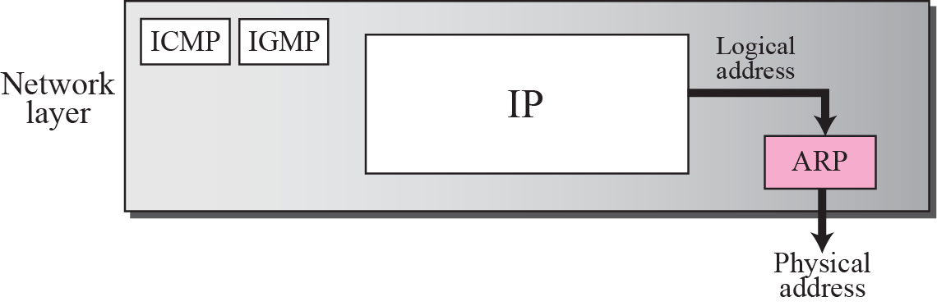
Anytime a host or a router has an IP datagram to send to another host or router, it has the logical (IP) address of the receiver.
But the IP datagram must be encapsulated in a frame to be able to pass through the physical network.
This means that the sender needs the physical address of the receiver.
A mapping corresponds a logical address to a physical address.
Figure 1.25 Position of ARP in TCP/IP protocol suite

Slide 48
Figure 1.26ARP operation
broadcast

Slide 49
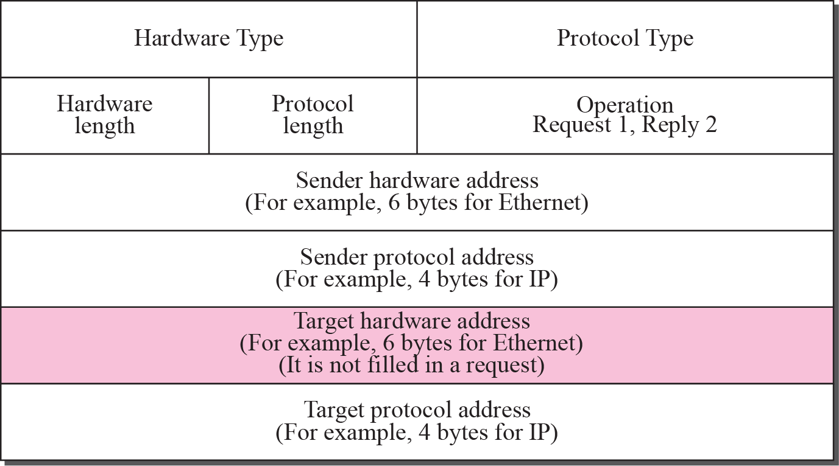
Figure 1.27 ARP packet

Slide 50
ARP Packet Format
The fields are as follows:
Hardware type: This is a 16-bit field defining the type of the network on which ARP is running.
Each LAN has been assigned an integer based on its type. For example, Ethernet is given the type 1. ARP can be used on any physical network.
Protocol type This is a 16-bit field defining the protocol.
For example, the value of this field for the IPv4 protocol is 080016.
ARP can be used with any higher-level protocol.
Hardware length: This is an 8-bit field defining the length of the physical address in bytes.
For example, for Ethernet the value is 6.
Protocol length: This is an 8-bit field defining the length of the logical address in bytes.
For example, for the IPv4 protocol the value is 4.
Operation: This is a 16-bit field defining the type of packet. Two packet types are defined: ARP request (1), ARP reply (2).

Slide 51
ARP Packet Format Cont.
Sender hardware address: This is a variable-length field defining the physical address of the sender.
For example, for Ethernet this field is 6 bytes long.
Sender protocol address: This is a variable-length field defining the logical (for example, IP) address of the sender.
For the IP protocol, this field is 4 bytes long.
Target hardware address: This is a variable-length field defining the physical
address of the target.
For example, for Ethernet this field is 6 bytes long.
For an ARP request message, this field is all 0s because the sender does not know the physical address of the target.
Target protocol address: This is a variable-length field defining the logical (for
example, IP) address of the target.
For the IPv4 protocol, this field is 4 bytes long.

Slide 52
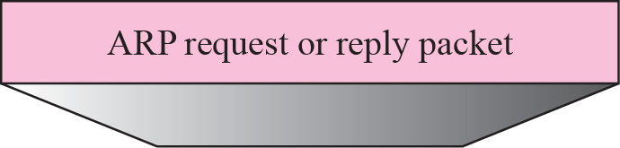
Figure 1.28 Encapsulation of ARP packet
Encapsulation
An ARP packet is encapsulated directly into a data link frame.
For example, an ARP packet is encapsulated in an Ethernet frame.
Note that the type field indicates that the data carried by the frame is an ARP packet.
Operation
Let us see how ARP functions on a typical internet.
First we discuss the four cases in which a host or router needs to use ARP.

Slide 53
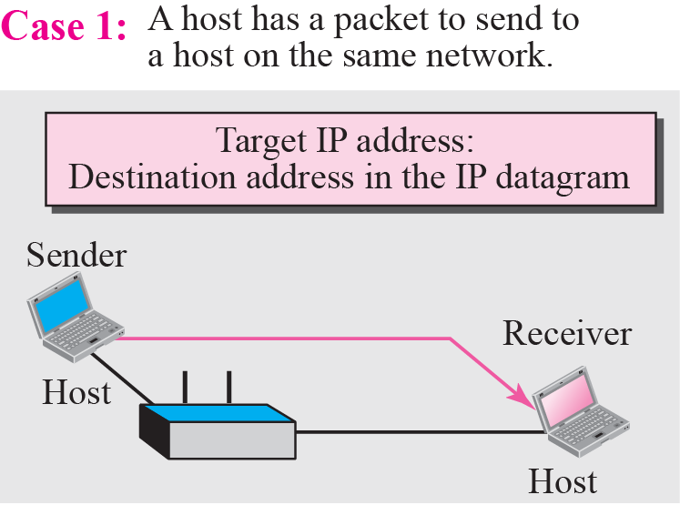
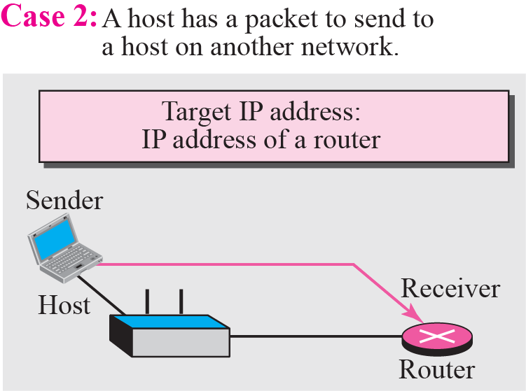
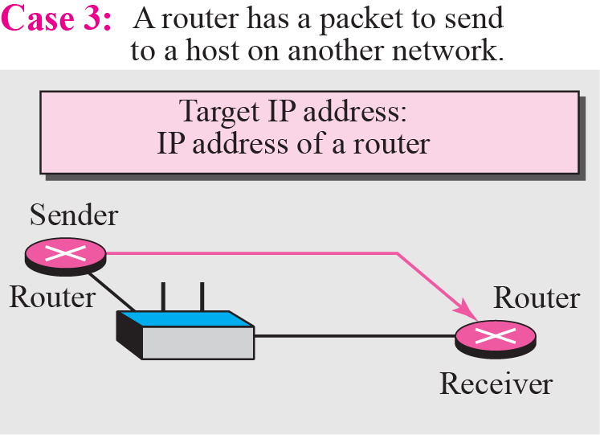
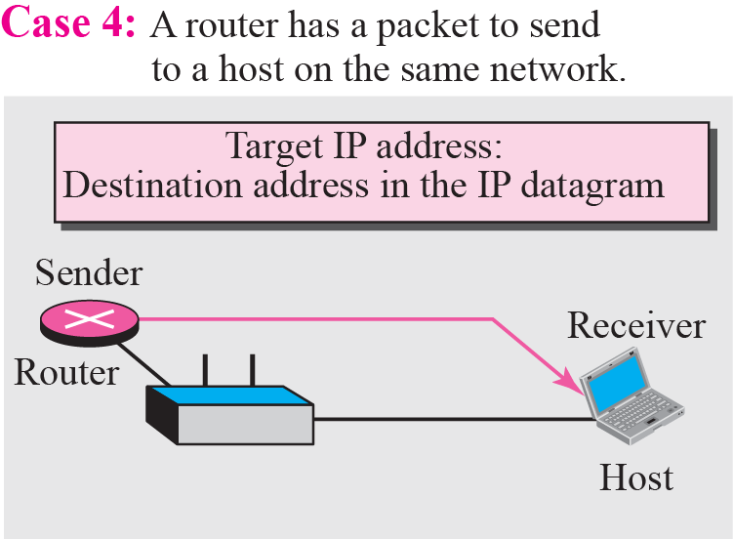
Figure 1.29 Four cases using ARP

Slide 54
Example 8.1
A host with IP address 130.23.43.20 and physical address B2:34:55:10:22:10 has a packet to send to another host with IP address 130.23.43.25 and physical address A4:6E:F4:59:83:AB. The two hosts are on the same Ethernet network. Show the ARP request and reply packets encapsulated in Ethernet frames.
Solution
Figure 1.30 shows the ARP request and reply packets. Note that the ARP data field in this case is 28 bytes, and that the individual addresses do not fit in the 4-byte boundary. That is why we do not show the regular 4-byte boundaries for these addresses. Also note that the IP addresses are shown in hexadecimal.

Slide 55
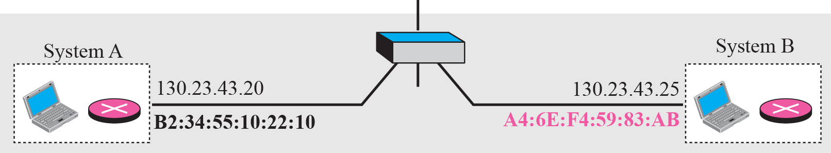
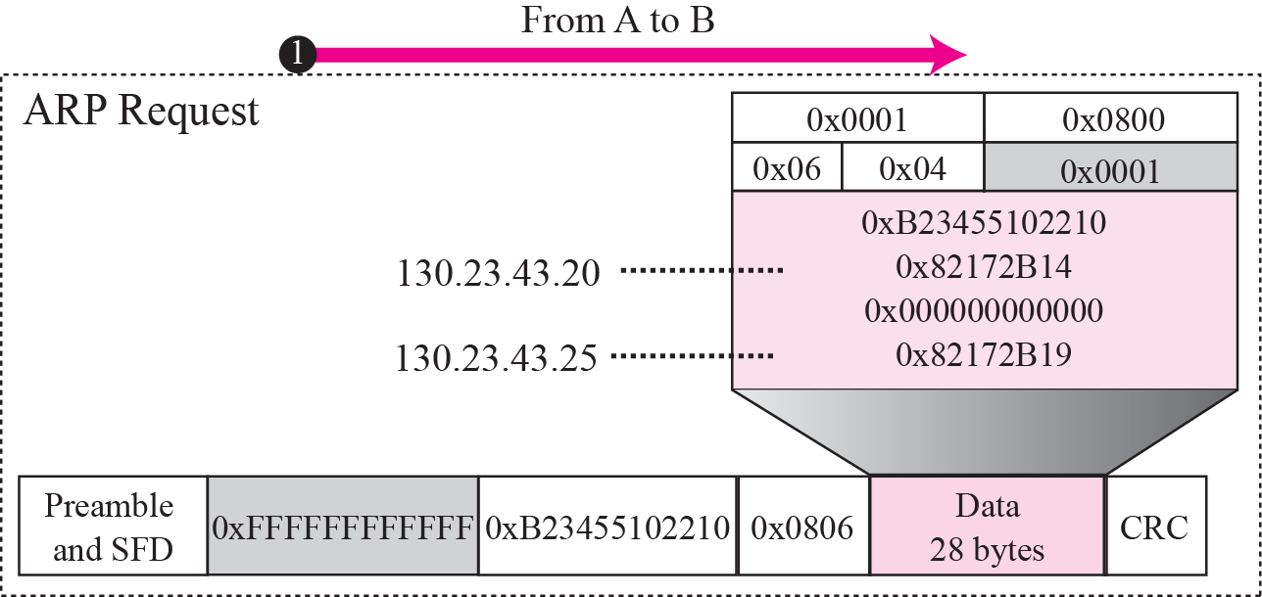
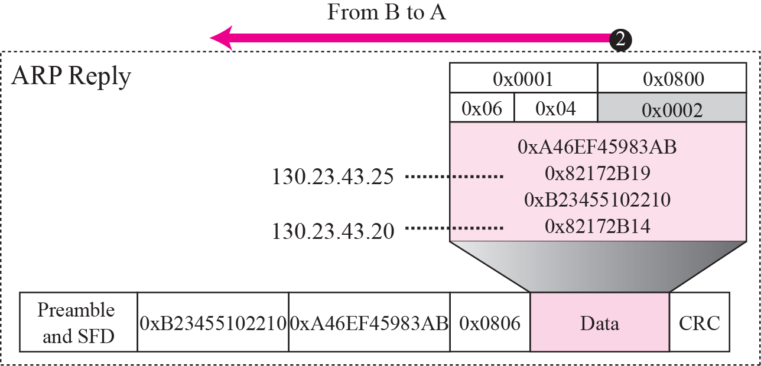
Figure 1.30 Example 1.26

Slide 56
Figure 1.31Proxy ARP
A proxy ARP is an ARP that acts on behalf of a set of hosts.
Whenever a router running a proxy ARP receives an ARP request looking for the IP address of one of these hosts, the router sends an ARP reply announcing its own hardware (physical) address.
After the router receives the actual IP packet, it sends the packet to the appropriate host or router.

Slide 57
ARP PACKAGE
we give an example of a simplified ARP software package.
The purpose is to show the components of a hypothetical ARP package and the relationships between the components.
We can say that this ARP package involves five components:
1) a cache table
2) Queues
3) an output module
4) an input module
5) a cache-control module.

Slide 58
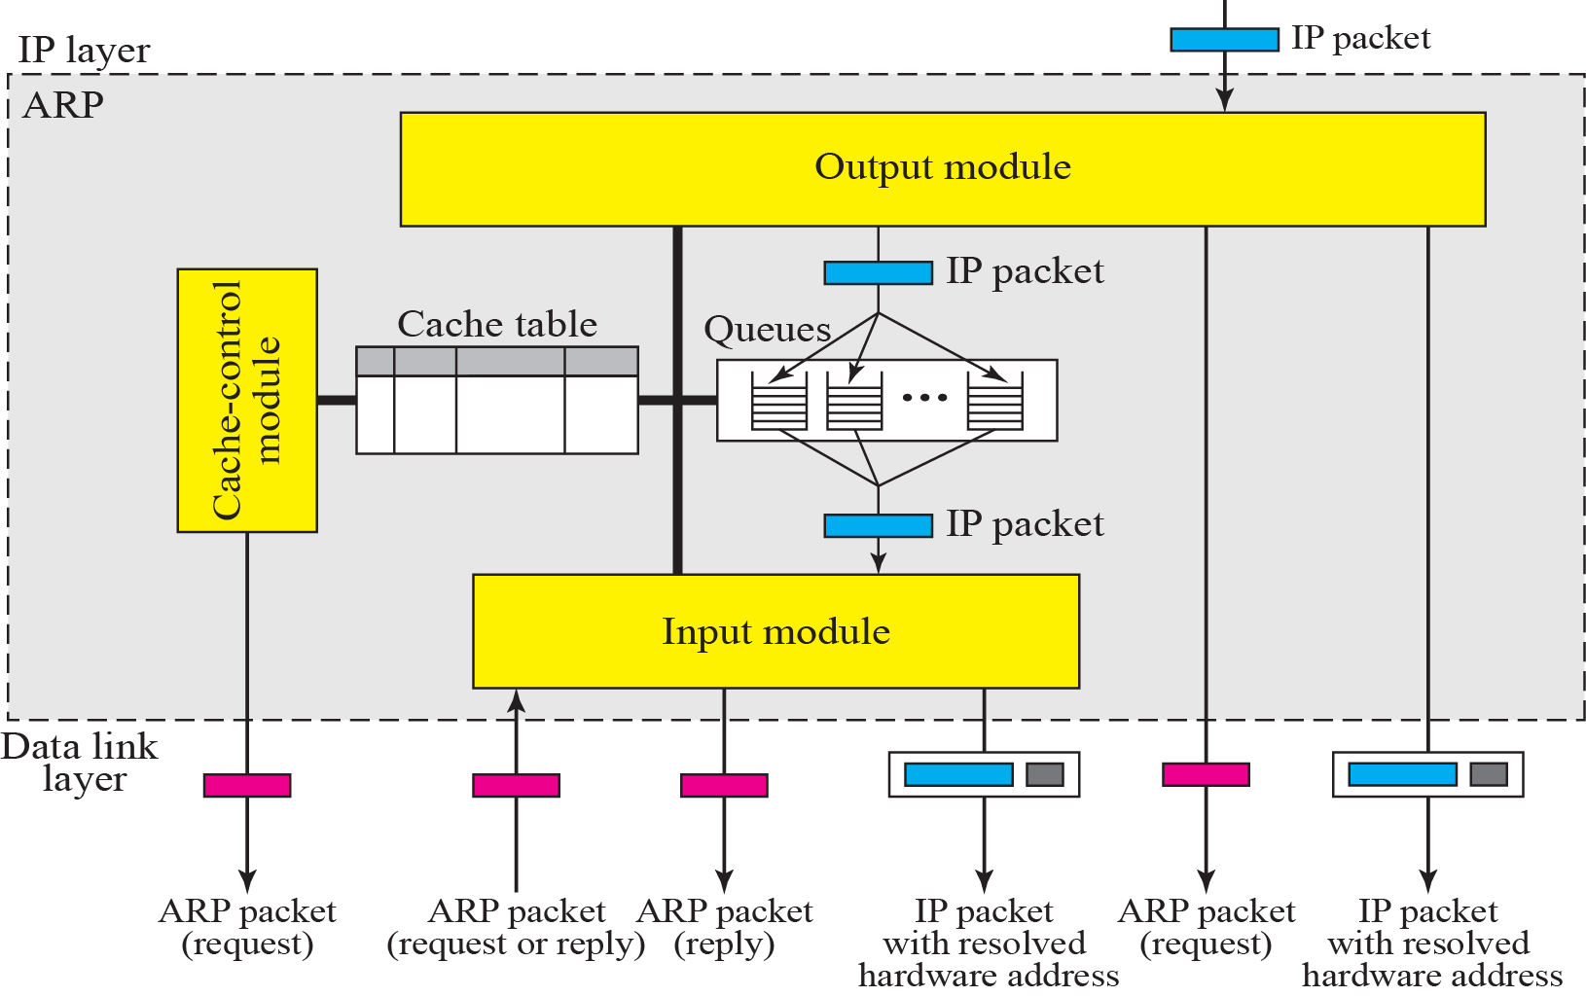
Figure 1.32 ARP components

Slide 59
ARP PACKAGE Cont.
Cache Table
A sender usually has more than one IP datagram to send to the same destination.
It is inefficient to use the ARP protocol for each datagram destined for the same host or router.
The solution is the cache table.
When a host or router receives the corresponding physical address for an IP datagram, the address can be saved in the cache table.
The cache table is implemented as an array of entries. In our package, each entry contains the following fields:
State: This column shows the state of the entry. It can have one of three values: FREE, PENDING, or RESOLVED.
Hardware type
Protocol type
Hardware length.

Slide 60
ARP PACKAGE Cont.
Protocol length
Interface number: A router (or a multihomed host) can be connected to different networks, each with a different interface number.
Each network can have different hardware and protocol types. Queue number: ARP uses numbered queues to enqueue the packets waiting for address resolution.
Packets for the same destination are usually enqueued in the same queue.
Attempts: This column shows the number of times an ARP request is sent out for this entry.
Time-out: This column shows the lifetime of an entry in seconds. Hardware address: This column shows the destination hardware address. It remains empty until resolved by an ARP reply.
Protocol address

Slide 61
Output Module

Slide 62
Input Module

Slide 63
Cache Control Module

Slide 65
Example 8.2
The ARP output module receives an IP datagram (from the IP layer) with the destination address 114.5.7.89. It checks the cache table and finds that an entry exists for this destination with the RESOLVED state (R in the table). It extracts the hardware address, which is 457342ACAE32, and sends the packet and the address to the data link layer for transmission. The cache table remains the same.

Slide 66
Example 8.3
Twenty seconds later, the ARP output module receives an IP datagram (from the IP layer) with the destination address 116.1.7.22. It checks the cache table and does not find this destination in the table. The module adds an entry to the table with the state PENDING and the Attempt value 1. It creates a new queue for this destination and enqueues the packet. It then sends an ARP request to the data link layer for this destination. The new cache table is shown in Table 8.6.

Slide 67
Example 8.4
Fifteen seconds later, the ARP input module receives an ARP packet with target protocol (IP) address 188.11.8.71. The module checks the table and finds this address. It changes the state of the entry to RESOLVED and sets the time-out value to 900. The module then adds the target hardware address (E34573242ACA) to the entry. Now it accesses queue 18 and sends all the packets in this queue, one by one, to the data link layer. The new cache table is shown in Table 8.7.

Slide 68
Twenty-five seconds later, the cache-control module updates every entry. The time-out values for the first three resolved entries are decremented by 60. The time-out value for the last resolved entry is decremented by 25. The state of the next-to-the last entry is changed to FREE because the time-out is zero. For each of the three pending entries, the value of the attempts field is incremented by one. After incrementing, the attempts value for one entry (the one with IP address 201.11.56.7) is more than the maximum; the state is changed to FREE, the queue is deleted, and an ICMP message is sent to the original destination See Table 8.8.

Slide 69
Reverse Address Resolution Protocol

Slide 70
RARP Procedure
Steps to Achieve the IP Address from RARP Server:
Source Device “Generates RARP Request Message” – The source device generates a RARP Request message. The Source puts its own data link-layer address as both the Sender Hardware Address and also the Target Hardware Address. It leaves both the Sender Protocol Address and the Target Protocol Address blank.
Source Device “Broadcasts RARP Request Message” – The source broadcasts the ARP Request message on the local network.
Local Devices “Process RARP Request Message” – The message is received by each device on the local network and processed. Devices that are not configured to act as RARP servers ignore the message.

Slide 71
RARP Procedure
4. RARP Server Generates RARP Reply Message: Any device on the network that is a RARP server responds to the broadcast from the source device. It generates a RARP Reply and sets the Sender Hardware Address and Sender Protocol Address to its own hardware and IP address of course. It looks up in a table the hardware address of the source, determines that device’s IP address assignment, and puts it into the Target Protocol Address field.
5. RARP Server Sends RARP Reply Message: The RARP server sends the RARP Reply message unicast to the device looking to be configured.
6. Source Device Processes RARP Reply Message: The source device processes the reply from the RARP server. It then configures itself using the IP address in the Target Protocol Address supplied
by the RARP server

Slide 72
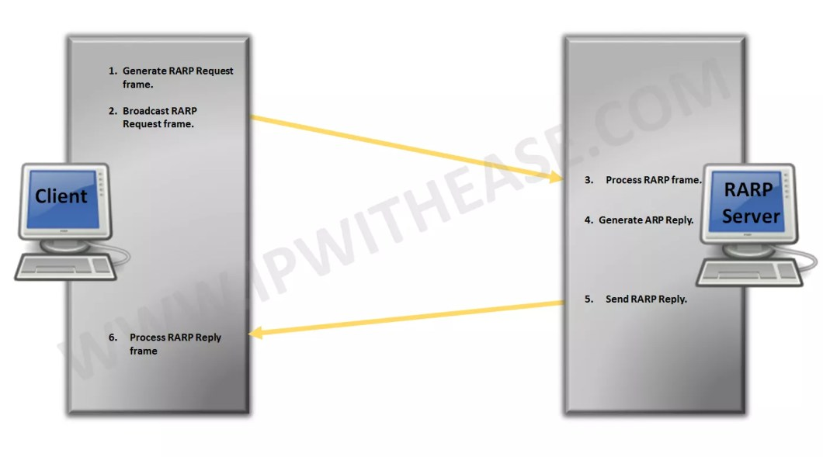
RARP Procedural Steps

Slide 73
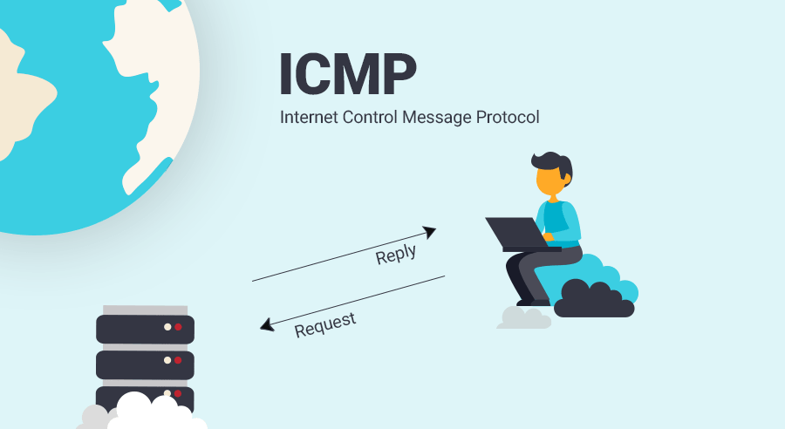

Slide 74
Introduction to Internet Control Message Protocol (ICMP)
IP protocol has no error-reporting or error-correcting mechanism
When errors occur, no built-in mechanism to notify the original host
IP protocol also lacks a mechanism for host and management queries
A host sometimes needs to determine if a router or another host is alive
Network manager needs information from another host and router

Slide 75
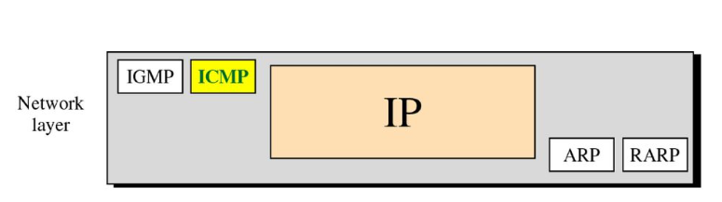
Introduction to Internet Control Message Protocol (ICMP)
Position of ICMP in the network layer

Slide 76
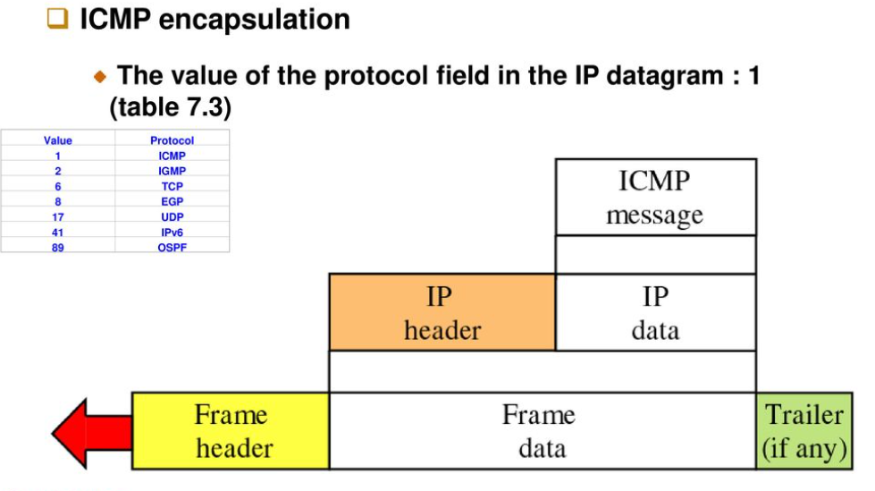
Introduction to Internet Control Message Protocol (ICMP)

Slide 77
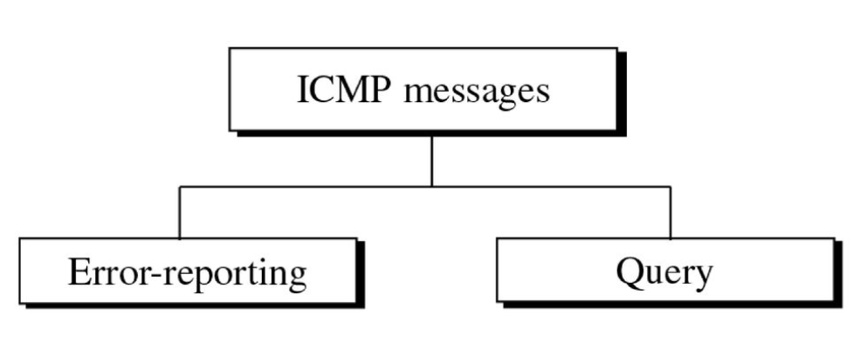
Types of Messages
Category of ICMP messages

Slide 78
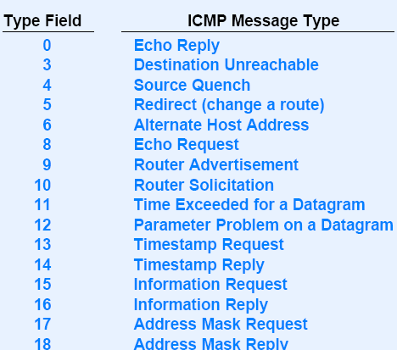
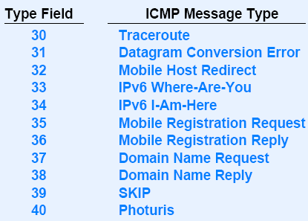
ICMP MESSAGE TYPES
Notes:
This hidden slide is for the reference of the students

Slide 79
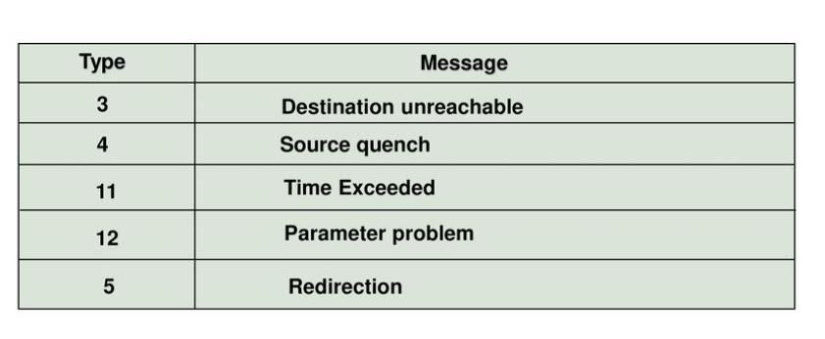
Types of Messages
CMP messages
Error reporting messages

Slide 80
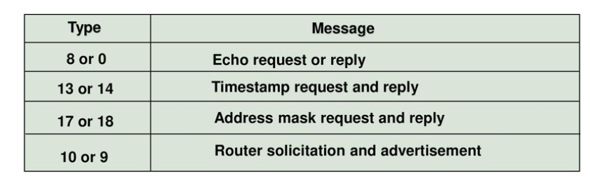
Types of Messages
ICMP messages
Query messages

Slide 81
Message Format
Having 8 byte header and variable-size data section
ICMP type : defining the type of the message
Code field : specifying the reason for the particular message type
Checksum field (for header and message)
Data section
In error message, carrying information for finding the original packet which caused the error
In query message, carrying extra information based on the type of the query

Slide 82
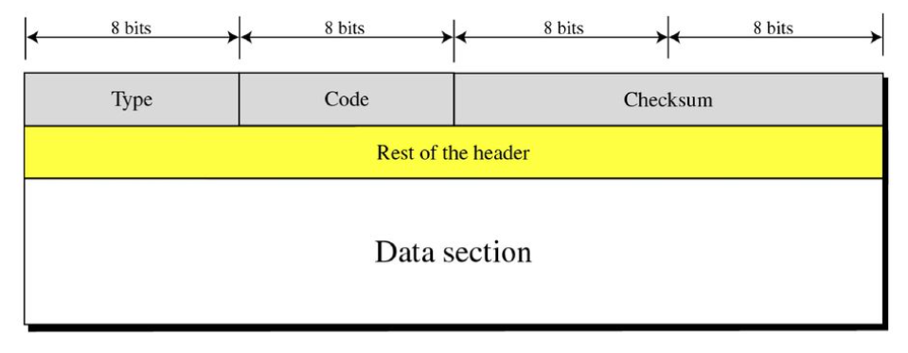
Message Format

Slide 83
Error Reporting
Error checking and control
Not correcting errors : it is left to the higher level protocols
Always reporting error messages to the original source

Slide 84
Error Reporting (cont’d)
Error checking and control
Not correcting errors : it is left to the higher level protocols
Always reporting error messages to the original source

Slide 85

Error Reporting (cont’d)
Error-reporting messages

Slide 86
Error Reporting (cont’d)
Important points about ICMP error messages
No ICMP error message will be generated in response to a datagram carrying an ICMP error message.
No ICMP error message will be generated for a fragmented datagram that is not the first fragment.
No ICMP error message will be generated for a datagram having a multicast address.
No ICMP error message will be generated for a datagram having a special address such as 127.0.0.0 or 0.0.0.0.

Slide 87
Error Reporting (cont’d)
All error messages
containing a data section that includes the IP header of the original datagram + the first 8 bytes of data in that IP datagram
8 bytes of data : port # (UDP and TCP ) and sequence # (TCP)
Used for informing to the protocols (TCP or UDP) about the error situation

Slide 88

Error Reporting (cont’d)
Contents of data field for the error messages

Slide 89

Error Reporting (cont’d)
Destination Unreachable
When a router cannot route a datagram or a host cannot deliver a datagram, the datagram is discarded.
Then, the router or the host sends a destination unreachable message back to the source that initiated the datagram.
Destination unreachable format

Slide 90
Error Reporting (cont’d)
Code 0 : network is unreachable, due to hardware failure, can only be generated by a router
Code 1 : host is unreachable, due to hardware failure, can only be generated by a router
Code 2 : protocol such as UDP, TCP or OSPF is not running at the moment.
generated only by the destination
Code 3 : the application program (process) that the datagram is destined for is not running at the moment
Code 4 : Fragmentation is required, but the DF (do not fragment) field has been set
Code 5 : Source routing cannot be accomplished
Code 6 : The destination network is unknown.
A router has no information about the destination network

Slide 91
Error Reporting (cont’d)
Code 7 : The destination host is unknown.
the router is unaware of the existence of the destination
Code 8 : The source host is isolated
Code 9 : Communication with the destination network is administratively prohibited
Code 10 : Communication with the destination host is administratively prohibited
Code 11 : the network is unreachable for the specified type of service
Code 12 : The host is unreachable for the specified type of service

Slide 92
Error Reporting (cont’d)
Code 13 : The host is unreachable because the administration has put a filter on it
Code 14 : The host is unreachable because the host precedence is violated. The requested precedence is not permitted for the destination
Code 15 : The host is unreachable because its precedence was cut off. This message is generated when the network operators have imposed a minimum level of precedence for the operation of the network

Slide 93
Error Reporting (cont’d)
Destination-unreachable messages with codes 2 or 3 can be created only by the destination host. Other destination-unreachable message can be created only by routers.
A router can not detect all problems that prevent the delivery of a packet.
The case that a datagram is traveling through an Ethernet network.
Ethernet does not provide any acknowledgement mechanism.

Slide 94

Error Reporting (cont’d)
Source Quench
is designed to add a kind of flow control to the IP
IP does not have a flow-control mechanism embedded in the protocol
when a router or host discards a datagram due to congestion, it sends a source-quench message to the sender of the datagram
making slow down the sending process

Slide 95
Error Reporting (cont’d)
Time exceeded
Whenever a router receives a datagram whose time-to-live field has the value of zero, it discards the datagram and sends a time-exceeded message to the original source
When the final destination does not receive all of the fragments in a set time, it discards the received fragments and sends a time-exceeded message to the original source

Slide 96

Error Reporting (cont’d)
In a time-exceeded message, code 0 is used only by routers to show that the value of the time-to-live field is zero. Code 1 is used only by the destination host to show that not all of the fragments have arrived within a set time
Time-exceeded message format

Slide 97

Error Reporting (cont’d)
Parameter-problem
A parameter-problem message caused by ambiguity in the header part can be created by a router or the destination host
Code 0 : error or ambiguity in one of the header fields
the value in the pointer field points to the byte with the problem
Code 1 : the required part of an option is missing. In this case, pointer is not used

Slide 98

Error Reporting (cont’d)
Redirection
A host usually starts with a small routing table that is gradually augmented and updated. One of the tools to accomplish this is the redirection message.
A redirection message is sent from a router to a host on the same local network.

Slide 99

Error Reporting (cont’d)
Redirection message format
Code 0 : redirection for the network-specific route
Code 1 : redirection for the host-specific route
Code 2 : redirection for network-specific route based on specific type of service
Code 3 : redirection for the host-specific route based on the specified type of servic

Slide 100

Query
Diagnosing some network problems
4 different pairs of messages

Slide 101
Query (cont’d)
Echo Request and Reply messages
designed for diagnostic purpose
the combination of echo-request and echo-reply messages determines whether 2 systems (hosts or routers) can communicate with each other
An echo-request message can be sent by a host or router. An echo-reply message is sent by the host or router which receives an echo-request message
Echo-request and echo-reply message can be used by network managers to check the operation of the IP protocol

Slide 102

Query (cont’d)
Echo-request and echo-reply messages can test the reachability of a host. This is usually done by invoking the ping command
Identifier and sequence number fields are not formally defined by the protocol and can be used by the sender
Echo-request and echo-reply message

Slide 103

Query (cont’d)
The identifier field The sequence number field
defines a group of problems
ex) process ID that originated the request
The sequence number field
keeps track of the particular echo request messages sent
At the user level
Invoking the packet Internet groper (ping) command

Slide 104
Query (cont’d)
Timestamp Request and Reply
2 machines (routers or hosts) can use the timestamp-request and timestamp-reply messages to determine the round-trip time needed for an IP datagram to travel between them
can used to synchronize the clocks in two machines
Three timestamp fields are each 32 bits long
holding a number representing time measured in milliseconds from midnight in Universal Time
Cannot exceed 86,400,000 = 24 x 60 x 60 x 1,000

Slide 105

Query (cont’d)
Timestamp-request and reply message format
original timestamp field : clock at departure time
receive timestamp field : at the time the request was received
transmit timestamp field : at the time the reply message departs

Slide 106
Query (cont’d)
The formulas for computing the one-way or round-trip time required for a datagram to go from a source to a destination and then back again.
Sending time = value of receive timestamp – value of original time stamp
Receiving time = time the packet returned – value of transmit timestamp
Round-trip time = sending time + receiving time

Slide 107
Query (cont’d)
Timestamp-request and timestamp reply message can be used to measure the round-trip time between a source and a destination machine even if their clocks are not synchronized
Example
Value of original timestamp : 46
Value of receive timestamp : 59
Value of transmit timestamp : 60
Time the packet arrived : 67
Sending time = 13 ms
Receiving time = 7 ms
Round-trip time = 20 ms

Slide 108

Query (cont’d)
Synchronizing clocks between two machines
Time difference = receive timestamp – (original timestamp field + oneway time duration)
In previous example,
Time difference = 59 – (46+10 ) = 3

Slide 109

Query (cont’d)
Address Mask Request and Reply
for differentiating among network address, subnetwork address and host ID
example, a host may know its 32-bit IP address as
left 20 bits are network and subnetwork addresses and remaining 12 bits are Host ID. In this case, following mask

Slide 110

Query (cont’d)
To obtain its mask,
A host sends an address-mask-request message to a router on the LAN. (unicast or broadcast)
If the host knows the address of the router, it sends the request directly to the router, if not, it broadcasts the message.

Slide 111
Query (cont’d)
Masking is needed for diskless stations at start-up time.
When a diskless station comes up for the first time
it may ask for its full IP address using RARP protocol
after receiving its IP address, it may use the address mask request and reply to find out which part of the address defines the subnet

Slide 112
Query (cont’d)
Router Solicitation and Advertisement
A host that wants to send data to a host on another network needs to know the address of routers connected to its own network.
the host should know if the routers are alive and functioning
A host can broadcast (or multicast) a router-solicitation message.
The router or routers that receive the solicitation message broadcast their routing information using the router-advertisement message.
A router can also periodically advertise router-advertisement messages even if no host has solicited

Slide 113

Query (cont’d)
Router-solicitation message format

Slide 114

Query (cont’d)
Router-advertisement message format
lifetime field : showing the number of seconds that entries are considered to be valid
address preference level defines the ranking of the router
preference level 0 : default router
preference level : the router should never be selected as the default router

Slide 115
Checksum
Checksum
calculating over the entire message (header and data)
Checksum calculation
Checksum field is set to zero
Sum of all the 16-bit words (header and data) is calculated
Sum is complemented to get the checksum
Checksum is stored in the checksum field

Slide 116

Checksum (cont’d)
Checksum testing Example,
the sum of all words (header and data) is calculated
the sum is completed
if the result obtained in step 2 is 16 0s, the message is accepted; otherwise, it is rejected.
Example,
A checksum is a small-sized block of data derived from another block of digital data for the purpose of detecting errors that may have been introduced during its transmission or storage. By themselves, checksums are often used to verify data integrity but are not relied upon to verify data authenticity.

Slide 117
ICMP– DEBUGGING TOOL
To check whether host or router is alive and running
To trace the route of a packet.
Two tools that use ICMP for debugging: ping and traceroute
Ping
The ping program to find if a host is alive and responding.
Command : ping the ip of the host.(ping 152.18.1.3)
The source host sends ICMP echo request messages (type: 8, code: 0);
The destination, if alive, responds with ICMP echo reply messages.

Slide 118
ICMP– DEBUGGING TOOL
Ping cont…
Starts the sequence number from 0; this number is incremented by one each time a
new message is sent.
ping can calculate the round-trip time.
Inserts the sending time in the data section of the message.
When packet arrives it subtracts the arrival time from the departure time to get the
Round-Trip Time (RTT).
The TTL (time to live) field is encapsulates an ICMP message as 62, which means the
packet cannot travel more than 62 hops

Slide 119
ICMP– DEBUGGING TOOL
Example : $ ping fhda.edu
PING fhda.edu (153.18.8.1) 56 (84) bytes of data.
64 bytes from tiptoe.fhda.edu (153.18.8.1): icmp_seq=0 ttl=62 time=1.91 ms
64 bytes from tiptoe.fhda.edu (153.18.8.1): icmp_seq=1 ttl=62 time=2.04 ms
64 bytes from tiptoe.fhda.edu (153.18.8.1): icmp_seq=2 ttl=62 time=1.90 ms
64 bytes from tiptoe.fhda.edu (153.18.8.1): icmp_seq=3 ttl=62 time=1.97 ms
64 bytes from tiptoe.fhda.edu (153.18.8.1): icmp_seq=4 ttl=62 time=1.93 ms
64 bytes from tiptoe.fhda.edu (153.18.8.1): icmp_seq=5 ttl=62 time=2.00 ms
64 bytes from tiptoe.fhda.edu (153.18.8.1): icmp_seq=6 ttl=62 time=1.94 ms
64 bytes from tiptoe.fhda.edu (153.18.8.1): icmp_seq=7 ttl=62 time=1.94 ms
64 bytes from tiptoe.fhda.edu (153.18.8.1): icmp_seq=8 ttl=62 time=1.97 ms
64 bytes from tiptoe.fhda.edu (153.18.8.1): icmp_seq=9 ttl=62 time=1.89 ms
64 bytes from tiptoe.fhda.edu (153.18.8.1): icmp_seq=10 ttl=62 time=1.98 ms
--- fhda.edu ping statistics ---
11 packets transmitted, 11 received, 0% packet loss, time 10103 ms
rtt min/avg/max = 1.899/1.955/2.041 ms

Slide 120
ICMP– DEBUGGING TOOL
Ping cont…
Ping data bytes as 56 and the total number of bytes as 84.
8 bytes ICMP header+ 20 bytes of IP header to 56 =84
ping defines the number of bytes as 64(56 + 8).
Interrupts message ctrl+c.
it prints the statistics of the probes
number of packets sent,
the number of packets received.
the total time
the RTT minimum, maximum, and average.

Slide 121

ICMP– DEBUGGING TOOL
TRACE ROUTE
The traceroute program in UNIX or tracert in Windows.
It is used to route the packets from source to destination.
Example Scenario
The Traceroute Program Operation

Slide 122
ICMP– DEBUGGING TOOL
Trace route cont….
In above example Given the topology, A packet from host A to host B travels through routers R1 and R2.
The traceroute program find the address of router R1 & RTT between host A and router R1.
The program repeats steps a to c three times to get a better average round-trip time.
a. Host A sends a packet to destination B using UDP the message is
encapsulated in an IP packet with a TTL value of 1. The program notes the time the packet is sent

Slide 123
ICMP– DEBUGGING TOOL
Trace route cont.….
b. Router R1 receives the packet and decrements the value of TTL to 0. It then discards the packet (because TTL is 0).
c. In receiver the ICMP messages uses the source address of the IP packet to find the IP address of router R1 and also makes note of the time the packet has arrived.
The traceroute program repeats the previous steps to find the address of router R2 and the round-trip time between host A and router R2.
The round-trip time between host A and host B.

Slide 124
ICMP– DEBUGGING TOOL
Trace route cont.….
Example: The traceroute program to find the route from the computer voyager.deanza.edu to the server fhda.edu. The following shows the result.
$ traceroute fhda.edu
traceroute to fhda.edu (153.18.8.1), 30 hops max, 38 byte packets
1 Dcore.fhda.edu (153.18.31.25) 0.995 ms 0.899 ms 0.878 ms
2 Dbackup.fhda.edu (153.18.251.4) 1.039 ms 1.064 ms 1.083 ms
3 tiptoe.fhda.edu (153.18.8.1) 1.797 ms 1.642 ms 1.757 ms
In the above example the destination is 153.18.8.1.
TTL value is 30 hops.
The packet contains 38 bytes: 20 bytes of IP header, 8 bytes of UDP header, and 10 bytes of application data.

Slide 125
ICMP– DEBUGGING TOOL
Trace route cont.….
The router is named Dcore.fhda.edu with IP address 153.18.31.254.
The Round Trip Time
1. 0.995 milliseconds,
2. 0.899 milliseconds
3. 0.878 milliseconds
The router is named Dbackup.fhda.edu with IP address 153.18.251.4.
The third line shows the destination host

Slide 126

ICMP DESIGN
To handle the ICMP sending and receiving messages
ICMP package made of two modules:
input module
output module

Slide 127
ICMP Design (cont’d)
Input module
handling all received ICMP message
invoked when an ICMP packet is delivered to it from the IP layer
if the received packet is a request or solicitation, the module creates a reply or an advertisement and sends it out
if the received packet is a redirection message, the module uses the information to update the routing table
if the received packet is an error message, the module informs the protocol about the situation that caused the error

Slide 128

INPUT MODULE
Pseudocode for Input Module

Slide 129
ICMP DESIGN
OUTPUT MODULE
responsible for creating request, solicitation, or error messages requested by a higher level or the IP protocol.
the module receives a demand from IP, UDP or TCP to send one of the ICMP error messages
if the demand is from IP
check first that request is allowed
ICMP message cannot be created for four situations;
ICMP error message
Fragmented IP packet
Multicast IP packet
IP packet having IP address or 127.X.Y.Z
May also receive a demand from an application program to send one of the ICMP request or solicitation messages

Slide 130

OUTPUT MODULE
Pseudocode for Output Module

Slide 131


Slide 132

USER DATAGRAM PROTOCOL
UDP – An Introduction
Connectionless service
Unreliable transport protocol.
No flow control / No Acknowledgement
Process to Process communication
Powerless
It uses minimum of over heads
No reliability is obtained using UDP
Less interaction between sender and receiver

Slide 133

USER DATAGRAM PROTOCOL
USER DATAGRAM
User datagram header format
Above picture depicts user data gram format
UDP packets are called user datagrams(messages)
It has fixed size header of 8 bytes

Slide 134
USER DATAGRAM PROTOCOL
UDP Datagram various fields
Source Port Number:
16 bits long – port ranges from 0-65535.
This port number will be used by the source host for identification.
Destination Port Number:
16 bits long.
Used by the process running on the Destination machine.
Application level service on end machine

Slide 135

USER DATAGRAM PROTOCOL
UDP Datagram various fields
Length:
UDP length=IP length – IP headers Length
Length field specifies the entire length of UDP packet (including header).
It is 16-bits field and minimum value is 8-byte, i.e. the size of UDP header itself.
A user datagram is encapsulated in an IP datagram.
Checksum:
This field is used to detect errors over the entire user datagram (header
plus data)
136

Slide 136

USER DATAGRAM PROTOCOL
UDP Services
Process to Process communication
UDP provides process-to-process communication using sockets, a combination of IP addresses and port numbers. Several port numbers used by UDP.

Slide 137
USER DATAGRAM PROTOCOL
UDP Services cont…
Connectionless services:
Connectionless service.
Each datagram is independent
even it comes from same source and delivered in same destination.
The datagrams are not numbered.
No connection establishments is done
cannot send a stream of data to UDP, It will chop them into different related user datagrams.
Flow control:
No Flow Control and no window
mechanism.
The receiver may overflow with
incoming messages.
UDP should provide for this service, if needed

Slide 138

USER DATAGRAM PROTOCOL
UDP Services cont…
Error Control:
Checksum
No Error control mechanism
except for checksum
Sender is unknown about the loss and duplication.
When error detects in receiver the datagram is discarded
Three sections: a pseudo header, the
UDP header, and the data coming from the application layer.
Pseudoheader for checksum calculation

Slide 139

USER DATAGRAM PROTOCOL
UDP Services cont…
Check Sum Calculation

Slide 140
USER DATAGRAM PROTOCOL
UDP receives data and add UDP header then pass to IP with socket.
IP add its own header using value 17 in protocol filed.
Indicating UDP protocol.
The IP datagram is then passed to the data link layer.
The data link layer receives the IP datagram and passes it to the physical layer.
The physical layer encodes the bits into electrical or optical signals and sends it to the remote machine.
UDP Services cont…
Congestion Control
It is a connectionless protocol so
congestion control not provided.
Encapsulation and Decapsulation
Encapsulation
A process send message through UDP
Along pair of socket address and
the length of data.

Slide 141

USER DATAGRAM PROTOCOL
UDP Services cont…
Decapsulation:
At the destination host:
the physical layer decodes the signals pass to data link layer.
The data link layer uses the header (and the
trailer) to check the data.
If there is no error
the header and trailer are dropped , datagram is passed to IP.
Encapsulation and Decapsul1a42tion

Slide 142
USER DATAGRAM PROTOCOL
UDP Services cont…
The header is dropped and the user datagram is passed to UDP with the sender and receiver IP addresses.
Checksum is to check the entire user datagram.
the header is dropped and the application data along with the sender socket address is passed to the process.
The sender socket address is passed to the process in case it needs to respond to the message received.

Slide 143

USER DATAGRAM PROTOCOL
UDP Services cont…
Queuing in UDP

Slide 144
USER DATAGRAM PROTOCOL
UDP Services cont…
Queuing in UDP
At the client site, when a process starts, it requests a port number from the operating system. Some implementations create both an incoming and an outgoing queue associated with each process. Other implementations create only an incoming queue associated with each process
process wants to communicate with multiple processes, it obtains only one port number and eventually one outgoing and one incoming queue. The queues opened by the client are, in most cases, identified by ephemeral port numbers. The queues function as long as the process is running. When the process terminates, the queues are destroyed.
The client process can send messages to the outgoing queue by using the source port number specified in the request

Slide 145
USER DATAGRAM PROTOCOL
UDP Services cont…
Queuing in UDP
The client process can send messages to the outgoing queue by using the source port number specified in the request
UDP removes the messages one by one and, after adding the UDP header, delivers them to IP. An outgoing queue can overflow
It happens the operating system can ask the client process to wait before sending any more messages

Slide 146
USER DATAGRAM PROTOCOL
UDP Services cont…
Applications of UDP:
Used for simple request response communication when size of data is less hence there is lesser concern about flow and error control.
It is suitable protocol for multicasting as UDP supports packet switching. Following implementations uses UDP as a transport layer protocol:
NTP (Network Time Protocol) DNS (Domain Name Service) BOOTP, DHCP.
NNP (Network News Protocol) Quote of the day protocol TFTP, RTSP, RIP, OSPF.
UDP is null protocol if you remove checksum field.
BOOTP (Bootstrap Protocol) is an internet protocol that lets a network user automatically be configured to receive an IP address and have an operating system booted without user involvement.
The Network News Transfer Protocol is an application protocol used for transporting Usenet news articles between news servers, and for reading/posting articles by the end user client applications.
Notes:
TFTP (Trivial File Transfer Protocol)
Real Time Streaming Protocol (RTSP)
Routing Information Protocol (RIP) is a distance vector protocol that uses hop count as its primary metric.

Slide 147
USER DATAGRAM PROTOCOL
UDP Services cont…
When to use UDP? Reduce the requirement of computer resources.
When using the Multicast or Broadcast to transfer.
The transmission of Real-time packets, mainly in multimedia applications

Slide 148

USER DATAGRAM PROTOCOL
UDP Package
UDP design

Slide 149
USER DATAGRAM PROTOCOL
UDP Package
The UDP package involves five components:
Control-Block Table
UDP has a control-block table to keep track of the open ports.
Each entry in this table has a minimum of four fields: the state, which can be FREE or IN-USE, the process ID, the port number, and the corresponding queue number.
Input Queues
Our UDP package uses a set of input queues, one for each process. In this design, we
do not use output queues.

Slide 150
USER DATAGRAM PROTOCOL
UDP Package
UDP_Control_Block_Module (process ID, port
Control-Block Module
number)
{
Search the table for a FREE entry. if (not found)
Delete one entry using a predefined strategy. Create a new entry with the state IN-USE Enter the process ID and the port number.
Return.
} // End module
The control-block module is responsible for the management of the control-block table.
When a process starts, it asks for a port number from the operating system.
The operating system assigns well- known port numbers to servers and ephemeral port numbers to clients.
The process passes the process ID and the port number to the control-block module to create an entry in the table for the process.

Slide 151
USER DATAGRAM PROTOCOL
UDP_INPUT_Module (user_datagram)
{
Look for the entry in the control_block table
if (found)
{
Check to see if a queue is allocated If (queue is not allocated)
allocate a queue else
enqueue the data
} //end if else
{
Ask ICMP to send an "unreachable port" message
Discard the user datagram
} //end else Return.
} // end module
UDP Package
Input Module
The input module receives a user datagram from the IP. It searches the control-block table to find an entry having the same port number as this user datagram.
If the entry is found, the module uses the information in the entry to enqueue the data.If the entry is not found, it generates an ICMP message..

Slide 152
USER DATAGRAM PROTOCOL
UDP Package
Output Module
The output module is responsible for creating and sending user datagrams. UDP_OUTPUT_MODULE (Data)
{
Create a user datagram Send the user datagram Return.
}

Slide 153
UDP Features at a Glance
UDP is connectionless
UDP uses ports for data transmission
UDP guarantees fast and delay-free communication
UDP doesn’t care about data integrity or reliability
UDP can be vulnerable to denial of service attacks (DDOS)

Slide 154
TCP Connection (A 3-way handshake)
Handshake refers to the process to establish connection between the client and server. Handshake is simply defined as the process to establish a communication link.
To transmit a packet, TCP needs a three way handshake before it starts sending data.
The reliable communication in TCP is termed as par (positive acknowledgement re-transmission).
When a sender sends the data to the receiver, it requires a positive acknowledgement from the receiver confirming the arrival of data.
If the acknowledgement has not reached the sender, it needs to resend that data.
The positive acknowledgement from the receiver establishes a successful connection.

Slide 155

Here, the server is the server and client is the receiver.
The above diagram shows 3 steps for successful connection.
A 3-way handshake is commonly known as SYN-SYN-ACK and requires both the client and server response to exchange the data.
SYN means synchronize Sequence Number and ACK means acknowledgment.
Each step is a type of handshake between the sender and the receiver.

Slide 156
The three handshakes are discussed in the below steps:
Step 1: SYN
SYN is a segment sent by the client to the server.
It acts as a connection request between the client and server. It informs the server that the client wants to establish a connection.
Synchronizing sequence numbers also helps synchronize sequence numbers sent between any two devices, where the same SYN segment asks for the sequence number with the connection request.

Slide 157
Step 2: SYN-ACK
It is an SYN-ACK segment or an SYN + ACK segment sent by the server.
The ACK segment informs the client that the server has received the connection request and it is ready to build the connection.
The SYN segment informs the sequence number with which the server is ready to start with the segments.

Slide 158
Step 3: ACK
ACK (Acknowledgment) is the last step before establishing a successful TCP connection between the client and server.
The ACK segment is sent by the client as the response of the received ACK and SN from the server. It results in the establishment of a reliable data connection.
After these three steps, the client and server are ready for the data communication process

Slide 159

Example : If a client wants to load a web page from the server then as per the previous slides The step 1,2 and 3 will perform as shown below

Slide 160

TCP Header
The following diagram represents the TCP header format-

Slide 161
1. Source Port-
Source Port is a 16 bit field.
It identifies the port of the sending application.
2. Destination Port-
Destination Port is a 16 bit field.
It identifies the port of the receiving application.
3. Sequence Number-
Sequence number is a 32 bit field.
TCP assigns a unique sequence number to each byte of data contained in the TCP segment.
This field contains the sequence number of the first data byte.

Slide 162
Acknowledgement Number-
Acknowledgment number is a 32 bit field.
It contains sequence number of the data byte that receiver expects to receive next from the sender.
It is always sequence number of the last received data byte incremented by 1.
Header Length-
Header length is a 4 bit field.
It contains the length of TCP header.
It helps in knowing from where the actual data begins.
Reserved Bits-
The 6 bits are reserved.
These bits are not used.

Slide 163
URG Bit-
URG bit is used to treat certain data on an urgent basis.
When URG bit is set to 1,
It indicates the receiver that certain amount of data within the current segment is urgent.
Urgent data is pointed out by evaluating the urgent pointer field.
The urgent data has be prioritized.
Receiver forwards urgent data to the receiving application on a separate channel.
ACK Bit-
ACK bit indicates whether acknowledgement number field is valid or not.
When ACK bit is set to 1, it indicates that acknowledgement number contained in the TCP header is valid.
For all TCP segments except request segment, ACK bit is set to 1.
Request segment is sent for connection establishment during Three Way Handshake.

Slide 164
PSH Bit-
PSH bit is used to push the entire buffer immediately to the receiving application.
When PSH bit is set to 1,
All the segments in the buffer are immediately pushed to the receiving application.
No wait is done for filling the entire buffer.
This makes the entire buffer to free up immediately.
RST Bit- RST bit is used to reset the TCP connection.
When RST bit is set to 1,
It indicates the receiver to terminate the connection immediately.
It causes both the sides to release the connection and all its resources abnormally.
The transfer of data ceases in both the directions.
It may result in the loss of data that is in transit.
This is used only when-
There are unrecoverable errors.
There is no chance of terminating the TCP connection normally.

Slide 165
SYN Bit- SYN bit is used to synchronize the sequence numbers.
When SYN bit is set to 1,
It indicates the receiver that the sequence number contained in the TCP header is the initial sequence number.
Request segment sent for connection establishment during Three way handshake contains SYN bit set to 1.
FIN Bit- FIN bit is used to terminate the TCP connection.
When FIN bit is set to 1,
It indicates the receiver that the sender wants to terminate the connection.
FIN segment sent for TCP Connection Termination contains FIN bit set to 1.

Slide 166
Window Size-
Window size is a 16 bit field.
It contains the size of the receiving window of the sender.
It advertises how much data (in bytes) the sender can receive without acknowledgement.
Thus, window size is used for Flow Control.
Checksum-
Checksum is a 16 bit field used for error control.
It verifies the integrity of data in the TCP payload.
Sender adds CRC checksum to the checksum field before sending the data.
Receiver rejects the data that fails the CRC check.

Slide 167
Urgent Pointer-
Urgent pointer is a 16 bit field.
It indicates how much data in the current segment counting from the first data byte is urgent.
Urgent pointer added to the sequence number indicates the end of urgent data byte.
This field is considered valid and evaluated only if the URG bit is set to 1.
Options-
Options field is used for several purposes.
The size of options field vary from 0 bytes to 40 bytes.

Slide 168
Options field is generally used for the following purposes-
Time stamp
Window size extension
Parameter negotiation
Padding
Time Stamp-
When wrap around time is less than life time of a segment,
Multiple segments having the same sequence number may appear at the receiver side.
This makes it difficult for the receiver to identify the correct segment.
If time stamp is used, it marks the age of TCP segments.
Based on the time stamp, receiver can identify the correct segment.

Slide 169
Window Size Extension-
Options field may be used to represent a window size greater than 16 bits.
Using window size field of TCP header, window size of only 16 bits can be represented.
If the receiver wants to receive more data, it can advertise its greater window size using this field.
The extra bits are then appended in Options field.
Parameter Negotiation-
Options field is used for parameters negotiation.
Example- During connection establishment,
Both sender and receiver have to specify their maximum segment size.
To specify maximum segment size, there is no special field.
So, they specify their maximum segment size using this field and negotiates.
Padding-
Addition of dummy data to fill up unused space in the transmission unit and make it conform to the standard size is called as padding.
Options field is used for padding.

Slide 170
Error Control in TCP
TCP protocol has methods for finding out corrupted segments, missing segments, out-of-order segments and duplicated segments.
Error control in TCP is mainly done through the use of three simple techniques :
Checksum – Every segment contains a checksum field which is used to find corrupted segments. If the segment is corrupted, then that segment is discarded by the destination TCP and is considered lost.
Acknowledgement – TCP has another mechanism called acknowledgement to affirm that the data segments have been delivered. Control segments that contain no data but have sequence numbers will be acknowledged as well but ACK segments are not acknowledged.

Slide 171
Retransmission
When a segment is missing, delayed to deliver to a receiver, corrupted when it is checked by the receiver then that segment is retransmitted again.
Segments are retransmitted only during two events: when the sender receives three duplicate acknowledgements (ACK) or when a retransmission timer expires.
Retransmission after RTO:
TCP always preserves one retransmission time-out (RTO) timer for all sent but not acknowledged segments.
When the timer runs out of time, the earliest segment is retransmitted. Here no timer is set for acknowledgement.
In TCP, the RTO value is dynamic in nature and it is updated using the round trip time (RTT) of segments.
RTT is the time duration needed for a segment to reach the receiver and an acknowledgement to be received by the sender.

Slide 172
Retransmission after Three duplicate ACK segments:
RTO method works well when the value of RTO is small.
If it is large, more time is needed to get confirmation about whether a segment has been delivered or not.
Sometimes one segment is lost and the receiver receives so many out-of-order segments that they cannot be saved.
In order to solve this situation, three duplicate acknowledgement method is used and missing segment is retransmitted immediately instead of retransmitting already delivered segment.
This is a fast retransmission because it makes it possible to quickly retransmit lost segments instead of waiting for timer to end.

Slide 173

TCP Flow Control

Slide 174

𝕿𝖗𝖆𝖓𝖘𝖒𝖎𝖘𝖘𝖎𝖔𝖓 𝕮𝖔𝖓𝖙𝖗𝖔𝖑 𝕻𝖗𝖔𝖙𝖔𝖈𝖔𝖑 (𝕿𝕮𝕻)
TCP Flow Control
Creates a balance between rate of data production and the rate of data consumption
Assumption: Channel between sender & receiver is error-free
Data Flow and Flow Control Feedbacks in TCP
Source: Behrouz A. Forouzan, “TCP IP Protocol Suite ” 4th edition, 2010, McGraw-Hill ISBN: 0073376043

Slide 175
𝕿𝖗𝖆𝖓𝖘𝖒𝖎𝖘𝖘𝖎𝖔𝖓 𝕮𝖔𝖓𝖙𝖗𝖔𝖑 𝕻𝖗𝖔𝖙𝖔𝖈𝖔𝖑 (𝕿𝕮𝕻)
TCP Flow Control Contd…
Messages are pushed from the Sending application to TCP Client
Message segment from TCP Client is pushed to TCP Server
Messages are pulled by receiving application from TCP Server
Flow control feedback is sent from TCP server to TCP client
TCP client forwards the flow control feedback to sending application
Opening and Closing Windows
Buffer size of sender & receiver is fixed during connection establishment
Window sizes of Sender / Receiver is controlled and adjusted by TCP Server
Opening / Closing / Shrinking of client window is controlled by receiver

Slide 176
𝕿𝖗𝖆𝖓𝖘𝖒𝖎𝖘𝖘𝖎𝖔𝖓 𝕮𝖔𝖓𝖙𝖗𝖔𝖑 𝕻𝖗𝖔𝖙𝖔𝖈𝖔𝖑 (𝕿𝕮𝕻)
TCP Flow Control Contd…
Scenario – TCP Flow Control
Segment 1
Connection request – (SYN) segment from client to server
Initial Sequence Number (ISN): 100 (Next byte to Arrive : 101)
Server allots buffer size = 800 (Assumption)
Server allots Window size (rwnd) = 800
Segment 2
(ACK + SYN) segment from Server to Client
Set ACK no = 101 & Buffer Size = 800 bytes

Slide 177
Flow Control – A Scenario
Source: Behrouz A. Forouzan, “TCP IP Protocol Suite ” 4th edition, 2010, McGraw-Hill ISBN: 0073376043

Slide 178
𝕿𝖗𝖆𝖓𝖘𝖒𝖎𝖘𝖘𝖎𝖔𝖓 𝕮𝖔𝖓𝖙𝖗𝖔𝖑 𝕻𝖗𝖔𝖙𝖔𝖈𝖔𝖑 (𝕿𝕮𝕻)
TCP Flow Control Contd…
Scenario – TCP Flow Control
Segment 3
ACK segment sent from client to server
Segment 4
Client sets window size to 800 (since rwnd from server is 800)
Client process pushes 200 bytes of data to TCP client
TCP client creates data segment with bytes (101-300) and sends to Server
Client window adjusted
Shows 200 bytes as sent but no ACK received from Server

Slide 179
𝕿𝖗𝖆𝖓𝖘𝖒𝖎𝖘𝖘𝖎𝖔𝖓 𝕮𝖔𝖓𝖙𝖗𝖔𝖑 𝕻𝖗𝖔𝖙𝖔𝖈𝖔𝖑 (𝕿𝕮𝕻)
TCP Flow Control Contd…
Scenario – TCP Flow Control
Shows 200 bytes as sent but no ACK received from Server
Server stores 200 bytes in buffer & closes receive window
Server indicates the next expected byte as 301
Segment 5
Server acknowledges receipt of 200 bytes from client & reduces rwnd to 600
Client receives acknowledgement and resizes window size to 600
Client closes the window (101-300) from left to right
Client indicates the next byte to send as 301

Slide 180
𝕿𝖗𝖆𝖓𝖘𝖒𝖎𝖘𝖘𝖎𝖔𝖓 𝕮𝖔𝖓𝖙𝖗𝖔𝖑 𝕻𝖗𝖔𝖙𝖔𝖈𝖔𝖑 (𝕿𝕮𝕻)
TCP Flow Control Contd…
Scenario – TCP Flow Control
Segment 6
Client pushes 300 more bytes to the server (Seq. No = 301 & Data = 300 bytes)
Server stores 300 bytes in buffer
100 bytes of data are pulled by the Client process
So, Window size is reduced by 100 bytes to the left & opened by 100 bytes to the right
Overall, TCP client window size is reduced by 200 bytes
Now, Receiver window size (rwnd) = 400

Slide 181
𝕿𝖗𝖆𝖓𝖘𝖒𝖎𝖘𝖘𝖎𝖔𝖓 𝕮𝖔𝖓𝖙𝖗𝖔𝖑 𝕻𝖗𝖔𝖙𝖔𝖈𝖔𝖑 (𝕿𝕮𝕻)
TCP Flow Control Contd…
Scenario – TCP Flow Control
Segment 7
TCP Server acknowledges receipt of 300 bytes and sets window size (rwnd) = 400 & TCP Client reduces window size to 400
Sender windows closes by 300 bytes from the left and opens by 100 bytes to the right
This process continues until all the data segments are sent from server to client and connection gets closed

Slide 182
𝕿𝖗𝖆𝖓𝖘𝖒𝖎𝖘𝖘𝖎𝖔𝖓 𝕮𝖔𝖓𝖙𝖗𝖔𝖑 𝕻𝖗𝖔𝖙𝖔𝖈𝖔𝖑 (𝕿𝕮𝕻)
TCP Flow Control Contd…
Shrinking of Windows
Shrinking : Decreasing window size i.e., right wall moves towards the left
Sender window may shrink based on rwnd value defined by receiver
Receiver window cannot shrink
Illustration
Upto 205 bytes of data received and acknowledged by sender
Last advertised rwnd = 12 (Window size) & last advertised ACK No = 206
Data can be sent from byte 206 to byte 217 (Since rwnd = 12)
New advertised rwnd = 12 (Window size) & new advertised ACK No = 210

Slide 183
The window after the new advertisement; Window has shrunk
Source: Behrouz A. Forouzan, “TCP IP Protocol Suite ” 4th edition, 2010, McGraw-Hill ISBN: 0073376043

Slide 184
𝕿𝖗𝖆𝖓𝖘𝖒𝖎𝖘𝖘𝖎𝖔𝖓 𝕮𝖔𝖓𝖙𝖗𝖔𝖑 𝕻𝖗𝖔𝖙𝖔𝖈𝖔𝖑 (𝕿𝕮𝕻)
TCP Flow Control Contd…
Shrinking of Windows Contd…
Shrinking of window has occurred from byte 217 to byte 213 (Window had moved from right to left
Shrinking can be prevented by the relation given below:
New ACK number + new rwnd > = Lask ACK Number + Last rwnd
To prevent shrinking,
Wait until enough buffer locations are available in its window

Slide 185
𝕿𝖗𝖆𝖓𝖘𝖒𝖎𝖘𝖘𝖎𝖔𝖓 𝕮𝖔𝖓𝖙𝖗𝖔𝖑 𝕻𝖗𝖔𝖙𝖔𝖈𝖔𝖑 (𝕿𝕮𝕻)
TCP Flow Control Contd…
Silly Window Syndrome
Occurs when either the sending process creates data slowly (or) the receiving process consumes data slowly (or) both
Silly window syndrome sends / receives data in small segments thus resulting in poor efficiency
Example
A 42 byte TCP datagram is needed to send Segment with 2 bytes of data
Overhead : 42 / 2 ⇒ Network capacity used inefficiently

Slide 186
𝕿𝖗𝖆𝖓𝖘𝖒𝖎𝖘𝖘𝖎𝖔𝖓 𝕮𝖔𝖓𝖙𝖗𝖔𝖑 𝕻𝖗𝖔𝖙𝖔𝖈𝖔𝖑 (𝕿𝕮𝕻)
TCP Flow Control Contd…
Silly Window Syndrome Created by Sender
Sending TCP creates syndrome since sending application program creates data slowly i.e., 1 byte at an instance
Suggestions
Prevent sending TCP from transmitting data byte by byte
Sending TCP made to wait & collect data to send data in larger block
Disadvantage: Waiting too long delays the process
Solution
Nagle’s Algorithm

Slide 187
𝕿𝖗𝖆𝖓𝖘𝖒𝖎𝖘𝖘𝖎𝖔𝖓 𝕮𝖔𝖓𝖙𝖗𝖔𝖑 𝕻𝖗𝖔𝖙𝖔𝖈𝖔𝖑 (𝕿𝕮𝕻)
TCP Flow Control Contd…
Nagle’s Algorithm for Silly Window Syndrome Created by Sender
First segment of data sent by sending TCP irrespective of the size of segment
Data is accumulated in buffer by sending TCP until acknowledgment is received from receiving TCP (or) enough data accumulated to send a segment
Repeat step 2 until transmission completes
Nagle’s algorithm works based on speed of application program and the network speed
Faster the application program larger the segment size
Advantage: Simple to implement

Slide 188
𝕿𝖗𝖆𝖓𝖘𝖒𝖎𝖘𝖘𝖎𝖔𝖓 𝕮𝖔𝖓𝖙𝖗𝖔𝖑 𝕻𝖗𝖔𝖙𝖔𝖈𝖔𝖑 (𝕿𝕮𝕻)
TCP Flow Control Contd…
Silly Window Syndrome Created by Receiver
Syndrome created when serving application consumes slowly
Example
1 KB data blocks created by sending application
1 byte of consumed at a time by receiving application
Once sending window buffer is full, window size (rwnd) becomes 0
Solution 1: Clarks’s Solution
Send ACK as data segment arrives
Set rwnd = 0 iff receive buffer is half empty (or) accommodate max size of segment

Slide 189
𝕿𝖗𝖆𝖓𝖘𝖒𝖎𝖘𝖘𝖎𝖔𝖓 𝕮𝖔𝖓𝖙𝖗𝖔𝖑 𝕻𝖗𝖔𝖙𝖔𝖈𝖔𝖑 (𝕿𝕮𝕻)
TCP Flow Control Contd…
Silly Window Syndrome Created by Receiver Contd…
Solution 2: Delayed Acknowledgment
Acknowledgement is withheld when segment arrives
Receiver waits for space in incoming buffer before acknowledging
Delayed ACK prevents sending TCP from sliding
Delayed ACK reduces network traffic
Note: ACK not to be delayed by more than 500 ms

Slide 190
TCP Error Control

Slide 191
𝕿𝖗𝖆𝖓𝖘𝖒𝖎𝖘𝖘𝖎𝖔𝖓 𝕮𝖔𝖓𝖙𝖗𝖔𝖑 𝕻𝖗𝖔𝖙𝖔𝖈𝖔𝖑 (𝕿𝕮𝕻)
TCP Error Control
TCP – Reliable Transport layer Protocol
Entire data stream to be delivered without error / loss / duplication
Reliability is provided by TCP using Error Control
Error Control includes:
Finding and resending corrupted segments
Resending lost segments
Storing out-of-order segments till missed segments arrive
Discarding duplicate segments
Error control achieved by: Checksum, Acknowledgement and Time-out

Slide 192
𝕿𝖗𝖆𝖓𝖘𝖒𝖎𝖘𝖘𝖎𝖔𝖓 𝕮𝖔𝖓𝖙𝖗𝖔𝖑 𝕻𝖗𝖔𝖙𝖔𝖈𝖔𝖑 (𝕿𝕮𝕻)
TCP Error Control Contd…
Checksum
TCP uses 16-bit mandatory checksum field
Checksum field associated with each segment
Checks for corrupted segment
Invalid Checksum: Segment discarded by receiving TCP & considered lost

Slide 193
𝕿𝖗𝖆𝖓𝖘𝖒𝖎𝖘𝖘𝖎𝖔𝖓 𝕮𝖔𝖓𝖙𝖗𝖔𝖑 𝕻𝖗𝖔𝖙𝖔𝖈𝖔𝖑 (𝕿𝕮𝕻)
TCP Error Control Contd…
Acknowledgement
Acknowledgement segments (ACK) carry no data & confirms data segment receipt
Types : Cumulative and Selective Acknowledgment
Cumulative Acknowledgment (ACK)
32-bit ACK field used
Acknowledges segments cumulatively (sets ACK flag to 1)
No feedback provided for discarded, lost or duplicate segments
Selective Acknowledgement (SACK)
Reports out of order & duplicate segments

Slide 194
𝕿𝖗𝖆𝖓𝖘𝖒𝖎𝖘𝖘𝖎𝖔𝖓 𝕮𝖔𝖓𝖙𝖗𝖔𝖑 𝕻𝖗𝖔𝖙𝖔𝖈𝖔𝖑 (𝕿𝕮𝕻)
TCP Error Control Contd…
Acknowledgement Contd…
No provision for SACK in TCP header
SACK included as part of options field in the TCP header
Rules for Generating Acknowledgments
When data is sent from sender to receiver, ACK provides the next Seq. No expected to be received
This results in less traffic and less segments between sender and receiver
In case of one in-order segment remaining, receiver needs to delay sending ACK segment. Network traffic is thus reduced.

Slide 195
𝕿𝖗𝖆𝖓𝖘𝖒𝖎𝖘𝖘𝖎𝖔𝖓 𝕮𝖔𝖓𝖙𝖗𝖔𝖑 𝕻𝖗𝖔𝖙𝖔𝖈𝖔𝖑 (𝕿𝕮𝕻)
TCP Error Control Contd…
Acknowledgement Contd…
At no point of time there should be more than two in-order segments unacknowledged. (avoid unnecessary retransmission)
Receiver acknowledges (ACK) an higher out-of-order sequence number immediately leading to fast retransmission of next segment
Receiver sends ACK when a missing segment arrives. Segments reported as missing are thus informed to the receiver
Receiver discards duplicate segment & sends ACK indicating the next in-order segment. Lost ACK segment problems are thus solved.

Slide 196
𝕿𝖗𝖆𝖓𝖘𝖒𝖎𝖘𝖘𝖎𝖔𝖓 𝕮𝖔𝖓𝖙𝖗𝖔𝖑 𝕻𝖗𝖔𝖙𝖔𝖈𝖔𝖑 (𝕿𝕮𝕻)
TCP Error Control Contd…
Retransmission of Segments
When retransmission occurs?
Expiry of retransmission timer (or)
Sender receives more than 2 duplicate ACK’s for 1st segment
Retransmission after RTO
One retransmission time-out (RTO) maintained by sending TCP for each connection
In case of time-out, timer is restarted by TCP & first segment of Queue is sent
This version of TCP is called Tahoe

Slide 197
𝕿𝖗𝖆𝖓𝖘𝖒𝖎𝖘𝖘𝖎𝖔𝖓 𝕮𝖔𝖓𝖙𝖗𝖔𝖑 𝕻𝖗𝖔𝖙𝖔𝖈𝖔𝖑 (𝕿𝕮𝕻)
TCP Error Control Contd…
Retransmission of Segments Contd…
Retransmission after 3 Duplicate Segments
Also called as Fast Retransmission & followed by most implementations
TCP version called as Reno
If 3 identical duplicate ACK’s along with the original ACK are received for a segment, the next segment is retransmitted
Note: Retransmission does not wait for time-out in this case

Slide 198
𝕿𝖗𝖆𝖓𝖘𝖒𝖎𝖘𝖘𝖎𝖔𝖓 𝕮𝖔𝖓𝖙𝖗𝖔𝖑 𝕻𝖗𝖔𝖙𝖔𝖈𝖔𝖑 (𝕿𝕮𝕻)
TCP Error Control Contd…
Out-of-Order Segments
Out-of-Order segments are not discarded by TCP
TCP flags such segments as out-of-order and store them temporarily until missing segments arrive
TCP makes sure that data segments are delivered in sequence to the process

Slide 199
𝕿𝖗𝖆𝖓𝖘𝖒𝖎𝖘𝖘𝖎𝖔𝖓 𝕮𝖔𝖓𝖙𝖗𝖔𝖑 𝕻𝖗𝖔𝖙𝖔𝖈𝖔𝖑 (𝕿𝕮𝕻)
TCP Error Control Contd…
FSM for Data Transfer in TCP
FSM – Finite State Machine
Similar to Selective repeat and Go Back-N protocol
Sender-side & Receiver Side FSM
Assumption : Unidirectional communication
Ignored Parameters: Selective ACK and Congestion Control
Nagle’s algorithm / Windows shutdown not included in FSM
Advantage: Fast transmission policy using 3 duplicate ACK segments
Bi-directional FSM : Complex and more practical

Slide 200
Simplified FSM for TCP Sender Side
Source: Behrouz A. Forouzan, “TCP IP Protocol Suite ” 4th edition, 2010, McGraw-Hill ISBN: 0073376043

Slide 201
Simplified FSM for TCP Receiver Side
Source: Behrouz A. Forouzan, “TCP IP Protocol Suite ” 4th edition, 2010, McGraw-Hill ISBN: 0073376043

Slide 202
TCP Congestion Control

Slide 203
𝕿𝖗𝖆𝖓𝖘𝖒𝖎𝖘𝖘𝖎𝖔𝖓 𝕮𝖔𝖓𝖙𝖗𝖔𝖑 𝕻𝖗𝖔𝖙𝖔𝖈𝖔𝖑 (𝕿𝕮𝕻)
TCP Congestion Control
Congestion window and congestion policy handles TCP congestion
Congestion Window
Client window size (rwnd) decided by the available buffer space of Server
Ignored entity in deciding window size : Network Congestion
Sender window size determined by,
rwnd (receiver advertised window size) &
cwnd (Congestion window size)
Actual window size = min (rwnd, cwnd)

Slide 204
𝕿𝖗𝖆𝖓𝖘𝖒𝖎𝖘𝖘𝖎𝖔𝖓 𝕮𝖔𝖓𝖙𝖗𝖔𝖑 𝕻𝖗𝖔𝖙𝖔𝖈𝖔𝖑 (𝕿𝕮𝕻)
TCP Congestion Control Contd…
TERMINOLOGIES & ABBREVIATIONS USED
rwnd – Sender Window Size
cwnd – Congestion Window Size
ssthresh – Slow Start Threshold
MSS – Maximum Segment Size
ACK – Acknowledgement
RTT – Round Trip Time
RTO – Retransmission Time-out

Slide 205
𝕿𝖗𝖆𝖓𝖘𝖒𝖎𝖘𝖘𝖎𝖔𝖓 𝕮𝖔𝖓𝖙𝖗𝖔𝖑 𝕻𝖗𝖔𝖙𝖔𝖈𝖔𝖑 (𝕿𝕮𝕻)
TCP Congestion Control Contd…
Congestion Policy
Three phases : Slow Start, Congestion avoidance & Congestion detection
Slow Start (Exponential Increase)
Assumption: rwnd(Sender Window Size) > cwnd(Congestion Window Size)
cwnd initialized to one Maximum window size (MSS)
On arrival of each ACK, cwnd increases by 1
Algorithm starts slowly & grows exponentially
Delayed ACK policy is ignored
Note: Consider each segment is individually acknowledged

Slide 206
Slow Start, Exponential Increase
Source: Behrouz A. Forouzan, “TCP IP Protocol Suite ” 4th edition, 2010, McGraw-Hill ISBN: 0073376043

Slide 207
𝕿𝖗𝖆𝖓𝖘𝖒𝖎𝖘𝖘𝖎𝖔𝖓 𝕮𝖔𝖓𝖙𝖗𝖔𝖑 𝕻𝖗𝖔𝖙𝖔𝖈𝖔𝖑 (𝕿𝕮𝕻)
TCP Congestion Control Contd…
Congestion Policy
Slow Start (Exponential Increase) contd…
Initial value of cwnd = 1 MSS
No of MSS sent | No of Segments Acknowledged | RTT | cwnd in MSS
Nil | Nil | - | 1
1 | 1 | 1 | 1 x 2 = 2 ⇒ 2¹
2 | 2 | 2 | 2 x 2 = 4 ⇒ 2²
4 | 4 | 3 | 4 x 2 = 8 ⇒ 2³
8 | 8 | 4 | 8 x 2 = 16 ⇒ 2⁴

Slide 208
𝕿𝖗𝖆𝖓𝖘𝖒𝖎𝖘𝖘𝖎𝖔𝖓 𝕮𝖔𝖓𝖙𝖗𝖔𝖑 𝕻𝖗𝖔𝖙𝖔𝖈𝖔𝖑 (𝕿𝕮𝕻)
TCP Congestion Control Contd…
Congestion Policy
Slow Start (Exponential Increase) contd…
For Delayed Acknowledgements
If multiple segments are acknowledged accumulatively, cwnd increases by 1
Example: if ACK = 4 then cwnd = 5
Growth is exponential but not to the power of 2
Slow start stops with a threshold value ssthresh
It stops when window size = = ssthresh

Slide 209
𝕿𝖗𝖆𝖓𝖘𝖒𝖎𝖘𝖘𝖎𝖔𝖓 𝕮𝖔𝖓𝖙𝖗𝖔𝖑 𝕻𝖗𝖔𝖙𝖔𝖈𝖔𝖑 (𝕿𝕮𝕻)
TCP Congestion Control Contd…
Congestion Policy
Congestion Avoidance : Additive Increase
Slow start increases congestion window size (cwnd) exponentially
Congestion avoidance increases cwnd additively
Additive phase begins when slow start reaches ssthresh i.e. cwnd = I
Increase in cwnd is based on RTT & not on number of ACK’s
RTT | cwnd in MSS
1 | i
2 | i + 1

Slide 210
Congestive avoidance, Additive Increase
Source: Behrouz A. Forouzan, “TCP IP Protocol Suite ” 4th edition, 2010, McGraw-Hill ISBN: 0073376043

Slide 211
𝕿𝖗𝖆𝖓𝖘𝖒𝖎𝖘𝖘𝖎𝖔𝖓 𝕮𝖔𝖓𝖙𝖗𝖔𝖑 𝕻𝖗𝖔𝖙𝖔𝖈𝖔𝖑 (𝕿𝕮𝕻)
TCP Congestion Control Contd…
Congestion Policy
Congestion Detection : Multiplicative Decrease
Size of Cwnd must be decreased in case of congestion
Retransmission occurs during missing segments / lost segments
Retransmission helps identify whether congestion has occurred or not
Retransmission occurs when
There is RTO Time-out
On receipt of three duplicate ACK’s
Note: In both cases, ssthresh is reduced by half (Multiplicative decrease)

Slide 212
𝕿𝖗𝖆𝖓𝖘𝖒𝖎𝖘𝖘𝖎𝖔𝖓 𝕮𝖔𝖓𝖙𝖗𝖔𝖑 𝕻𝖗𝖔𝖙𝖔𝖈𝖔𝖑 (𝕿𝕮𝕻)
TCP Congestion Control Contd…
Congestion Policy
Congestion Detection : Multiplicative Decrease Contd…
Time-out increases possibility of congestion. TCP reacts as follows:
Ssthresh set to half the value of rwnd
Cwnd initialized to 1
Slow start phase is initiated again
Three duplicate ACK’s indicates a weaker possibility of Congestion. Also called as fast transmission & fast recovery. TCP reacts as follows:
Ssthresh set to half the value of rwnd

Slide 213
𝕿𝖗𝖆𝖓𝖘𝖒𝖎𝖘𝖘𝖎𝖔𝖓 𝕮𝖔𝖓𝖙𝖗𝖔𝖑 𝕻𝖗𝖔𝖙𝖔𝖈𝖔𝖑 (𝕿𝕮𝕻)
TCP Congestion Control Contd…
Congestion Policy
Congestion Detection : Multiplicative Decrease Contd…
Cwnd = ssthresh
Congestion avoidance phase is initiated again

Slide 214
TCP Congestion Policy : A Summary
Source: Behrouz A. Forouzan, “TCP IP Protocol Suite ” 4th edition, 2010, McGraw-Hill ISBN: 0073376043

Slide 215
𝕿𝖗𝖆𝖓𝖘𝖒𝖎𝖘𝖘𝖎𝖔𝖓 𝕮𝖔𝖓𝖙𝖗𝖔𝖑 𝕻𝖗𝖔𝖙𝖔𝖈𝖔𝖑 (𝕿𝕮𝕻)
TCP Congestion Control Contd…
Summarization with Example
Assumptions
Maximum window Size (MSS) = 32
Threshold (ssthresh) = 16
TCP moves to slow start
rwnd starts from 1 and and grows exponentially till it reaches ssthresh (16)
Additive increase increases rwnd from 16 to 20 (one by one)
When rwnd = 20, time-out occurs
Multiplicative Decrease: ssthresh reduced to 10 (half the window size)

Slide 216
Congestion Example
Source: Behrouz A. Forouzan, “TCP IP Protocol Suite ” 4th edition, 2010, McGraw-Hill ISBN: 0073376043

Slide 217
𝕿𝖗𝖆𝖓𝖘𝖒𝖎𝖘𝖘𝖎𝖔𝖓 𝕮𝖔𝖓𝖙𝖗𝖔𝖑 𝕻𝖗𝖔𝖙𝖔𝖈𝖔𝖑 (𝕿𝕮𝕻)
TCP Congestion Control Contd…
Summarization with Example Contd…
New ssthresh = 10
TCP moves to Slow start again
rwnd starts from 1 and and grows exponentially till it reaches new ssthresh (10)
Additive increase increases rwnd from 10 to 12 (one by one)
2 duplicate ACK’s are received by the sender
Multiplicative Decrease: ssthresh reduced to 6 (half the window size)

Slide 218
Multicasting and Multicast Routing Protocols
Objectives
Upon completion you will be able to:
Differentiate between a unicast, multicast, and broadcast message
Know the many applications of multicasting
Understand multicast link state routing and MOSPF
Understand multicast link state routing and DVMRP
Understand the Core-Based Tree Protocol
Understand the Protocol Independent Multicast Protocols
Understand the MBONE concept

Slide 219
UNICAST, MULTICAST, AND BROADCAST
A message can be unicast, multicast, or broadcast. Let us clarify these terms as they relate to the Internet.
The topics discussed in this section include:
Unicasting
Multicasting
Broadcasting
Multicasting versus Multiple Unicasting

Slide 220

Unicasting

Slide 221
Note:
In unicasting, the router forwards the received packet through only one of its interfaces.

Slide 222

Multicasting

Slide 223
Note:
In multicasting, the router may forward the received packet through several of its interfaces.

Slide 224

Multicasting versus multiple unicasting

Slide 225
Note:
Emulation of multicasting through multiple unicasting is not efficient and may create long delays, particularly with a large group.

Slide 226
MULTICAST APPLICATIONS
Multicasting has many applications today such as access to distributed databases, information dissemination, teleconferencing, and distance learning.
The topics discussed in this section include:
Access to Distributed Databases
Information Dissemination
Dissemination of News
Teleconferencing
Distance Learning

Slide 227
MULTICAST ROUTING
In this section, we first discuss the idea of optimal routing, common in all multicast protocols. We then give an overview of multicast routing protocols.
The topics discussed in this section include:
Optimal Routing: Shortest Path Trees
Routing Protocols

Slide 228
Note:
In unicast routing, each router in the domain has a table that defines a shortest path tree to possible destinations.

Slide 229

Shortest path tree in unicast routing

Slide 230
Note:
In multicast routing, each involved router needs to construct a shortest path tree for each group.

Slide 231
Note:
In the source-based tree approach, each router needs to have one shortest path tree for each group.

Slide 232

Source-based tree approach

Slide 233

Group-shared tree approach

Slide 234
Note:
In the group-shared tree approach, only the core router, which has a shortest path tree for each group, is involved in multicasting.

Slide 235

Taxonomy of common multicast protocols

Slide 236
MULTICAST LINK STATE ROUTING: MOSPF
In this section, we briefly discuss multicast link state routing and its implementation in the Internet, MOSPF.
The topics discussed in this section include:
Multicast Link State Routing
MOSPF

Slide 237
Note:
Multicast link state routing uses the source-based tree approach.

Slide 238
MULTICAST DISTANCE VECTOR: DVMRP
In this section, we briefly discuss multicast distance vector routing and its implementation in the Internet, DVMRP.
The topics discussed in this section include:
Multicast Distance Vector Routing
DVMRP

Slide 239
Note:
Flooding broadcasts packets, but creates loops in the systems.

Slide 240
Note:
RPF eliminates the loop in the flooding process.

Slide 241

RPF

Slide 242

Problem with RPF

Slide 243

RPF versus RPB

Slide 244
Note:
RPB creates a shortest path broadcast tree from the source to each destination.
It guarantees that each destination receives one and only one copy of the packet.

Slide 245

RPF, RPB, and RPM

Slide 246
Note:
RPM adds pruning and grafting to RPB to create a multicast shortest path tree that supports dynamic membership changes.

Slide 247
CBT
The Core-Based Tree (CBT) protocol is a group-shared protocol that uses a core as the root of the tree. The autonomous system is divided into regions and a core (center router or rendezvous router) is chosen for each region.
The topics discussed in this section include:
Formation of the Tree
Sending Multicast Packets
Selecting the Rendezvous Router

Slide 248

Group-shared tree with rendezvous router

Slide 249

Sending a multicast packet to the rendezvous router

Slide 250
Note:
In CBT, the source sends the multicast packet (encapsulated in a unicast packet) to the core router. The core router decapsulates the packet and forwards it to all interested interfaces.

Slide 251
PIM
Protocol Independent Multicast (PIM) is the name given to two independent multicast routing protocols: Protocol Independent Multicast, Dense Mode (PIM-DM) and Protocol Independent Multicast, Sparse Mode (PIM-SM).
The topics discussed in this section include:
PIM-DM
PIM-SM

Slide 252
Note:
PIM-DM is used in a dense multicast environment, such as a LAN.

Slide 253
Note:
PIM-DM uses RPF and pruning/grafting strategies to handle multicasting. However, it is independent from the underlying unicast protocol.

Slide 254
Note:
PIM-SM is used in a sparse multicast environment such as a WAN.

Slide 255
Note:
PIM-SM is similar to CBT but uses a simpler procedure.

Slide 256
MBONE
A multicast router may not find another multicast router in the neighborhood to forward the multicast packet. A solution for this problem is tunneling. We make a multicast backbone (MBONE) out of these isolated routers using the concept of tunneling.

Slide 257

Logical tunneling

Slide 258

MBONE

